Slide 1

The Trustmark Companies
PRESENTER

Slide 2
Agenda
Who is Trustmark?
Alignment with Gallagher:
  Areas of Expertise
  Ongoing Partnerships
  Market Focus
  Care Study
Business Overview
  CoreSource
  Insights & Analytics
Leveraging Trustmark
  Why Trustmark?
  Next Steps
Notes:
Thank you. It’s great to be part of Gallagher Benefit Services first ever Global Sales Conference. [Introduce yourself, role, time with company, etc.]
Trustmark may not be a name that all of you recognize. I’m here to change that.
We may not have a high profile, but we have a long history and deep expertise in across a broad range of employee benefits.
And two of our four businesses have been partnering with Gallagher for many years. We see many similarities between Trustmark and Gallagher – your values, your approach and your commitment to helping organization create and sustain a destination workplace.
I’m going to kick this off with a two-minute video that introduces the four businesses that are Trustmark. Then I’ll cover some areas of specific overlap in focus and markets. That will lead to a more in-depth look at the business I represent, CoreSource, and a case study in one of Gallagher’s main areas of focus, .
I’ll close with how we are the right partner to help you deliver for your clients. Because this relationship is one we want to grow aggressively – to our mutual benefit.
[Click to play overview video]

Slide 3
Trustmark: A Dynamic Enterprise

Slide 4


Slide 5











Listening leads to understanding. Understanding builds trust.
“One” Trustmark
Trustmark Value
Proposition
We listen first
Expertise to solve complex employee benefit challenges
We build trusted partnerships
The result? A coherent benefit strategy that fits our customer’s culture, protects and improves the wellbeing of their employees, advances their employment brand and achieves business goals.
Expertise in voluntary benefits, self-funded health benefit plan design and administration (TPA services), and population health management solutions.
We help people and businesses thrive.
Founded in 1913
$2.1 billion in assets
4,150 associates
25+ offices
Notes:
As you saw in the video, the One Gallagher theme resonates with us because Trustmark’s businesses are working more closely together than ever before.
Here’s what makes Trustmark different. We’re big enough to have the resources to innovate and deliver sophisticated employee benefit solutions. But we’re small enough to still be a relationship-based company. What do I mean by that? For us, the relationship comes first. The products and services are all there and available, but we listen to you to learn what you’re clients’ biggest most difficult challenges are so we aren’t pushing products, but driving toward sustainable solutions that achieve their goals.
How do we do that? Through four businesses that each bring long experience and deep expertise to a different aspect of employees benefits.
Trustmark Voluntary Benefit Solutions offers financial protection to employees that fits their life stage and priorities – all designed by listening to what they care about and need most.
CoreSource is one of the largest third-party health plan administrators in the country, with more technology and resources than regional TPAs to design a complete, seamless benefit plan and greater flexibility to suite individual business needs than the large national carriers.
HealthFitness delivers population health and fitness center management, combining a proven, science-based behavior change model with people-based, personalized paths to wellness.
Starmark provides self-funding options for small businesses, down to 5 employees.
It’s all about earning and maintaining trust. Helping you solve your clients complex employee benefit challenges. Trustmark Voluntary Benefit Solutions, CoreSource, HealthFitness and Starmark.

Slide 6

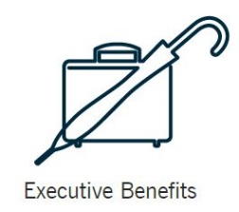
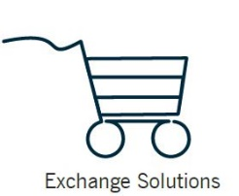


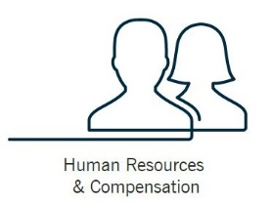







Alignment with Gallagher
Life/Wholesale
Gallagher Core Competencies
Wellbeing & Engagement
Notes:
We got these icons from your team because we wanted to show how our areas of expertise line up with your core competencies.
With so much change in the benefits industry, it’s critical to work with a partner with experience helping clients navigate those complexities. Trustmark has that experience.
HealthFitness of course has been providing health and wellness services since 1975 and helps employers drive participation through a culture of health.
CoreSource provides detailed reports and plan analytics to help you support your clients in managing costs, increasing employee satisfaction with their benefit plan and achieving sustainable results.
And Trustmark Voluntary Benefit Solutions of course specializes in voluntary benefits, including Universal Life with Living Benefits, as well as HR and benefits technology that simplifies administration.

Slide 7



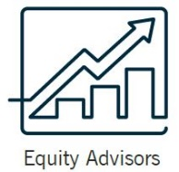


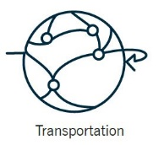

Alignment with Gallagher
Gallagher Industry Practices
Notes:
We’re aligned as well on the industries we serve.
CoreSource specializes in hospitals and health systems, but also serves municipalities and religious and nonprofit organizations. [Say a bit more about this – bring in anything we’re missing.]
HealthFitness has a growing niche in serving universities, while also meeting the demands of a number of Fortune 50 clients.
And many of our shared clients in Trustmark Voluntary Benefit Solutions are in the public sector – school systems, municipalities and more.

Slide 8
Shared Market Focus
Middle Market Focus
5,000+
Three growth businesses strategically aligned
Offering deep expertise in VB, self-funded plan design & admin. and population health
Mid-size companies get benefit sophistication of large employers
Attention and service from a company that cares
4,000
3,000
2,000
1,000
100
Trustmark Voluntary Benefit Solutions
CoreSource
HealthFitness
Notes:
In addition, we share a specific commitment to middle market employers. While HealthFitness has traditionally served large employers, we are investing in a new technology platform that will enable them to bring wellness programming to midsize companies that has until now only been available (and scalable) for large employers.
This means Trustmark has three businesses strategically – and culturally – aligned to help you bring together a wide range of expertise to benefit your clients.

Slide 9












A Growing Relationship
Benefit Plan Administration
Voluntary Benefits
Notes:
Our relationship is a growing one that we want to continue to expand. These are just a few of the Gallagher clients that get third-party administrative services from CoreSource or voluntary benefits from Trustmark Voluntary Benefit Solutions.

Slide 10
Client Success Story
Case Study: Helping a 6000+ employee client use its HR resources more effectively
Solution: CoreSource implemented its 24/7 Advocacy with digital support and connection tools
Problem: Client did not have a way to support effective client communications for their benefit-related and other company matters across its 3 shifts
Results: Client cited its ability to redeploy 2/3 of its HR Benefits Communication resources as a direct result of the new CoreSource support programs and tools. At next renewal, client will incorporate our new texting capabilities to get further gains.
Notes:
Replace these with a CoreSource example of two if we have good ones.

Slide 11

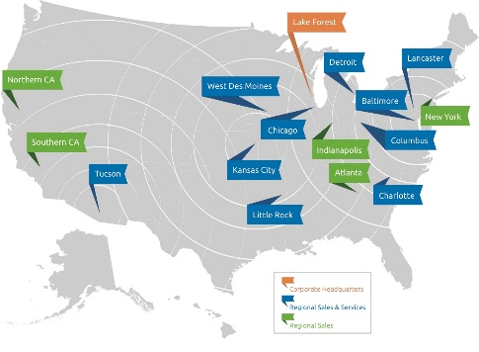
More About:
Self-funded employee health benefits
One of the largest / 40+ years
11 local / regional offices
500+ clients / 1.3 million members
11MM claims / $3B Paid per year
Notes:
A brief look at my area of expertise, CoreSource. You have materials in your folders about the other three Trustmark businesses, and we have representatives here from the three middle-market focused businesses who can answer questions and provide more information.

Slide 12
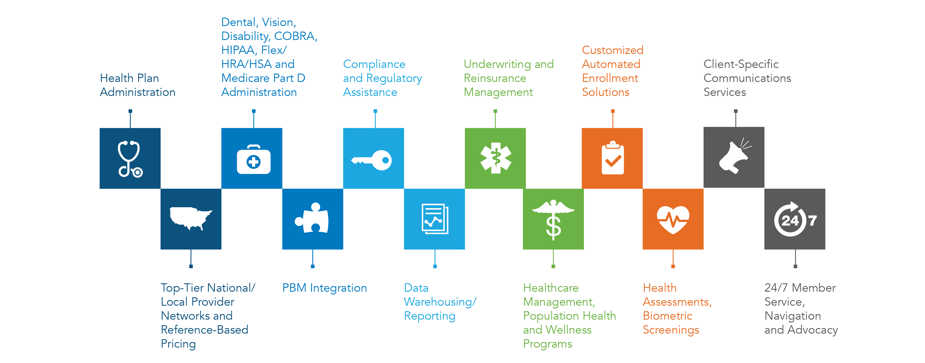
An Unmatched Range of Solutions
Notes:
Range of Services = Competitive Differentiator
More resources and range of services than local and regional TPAs

Slide 13
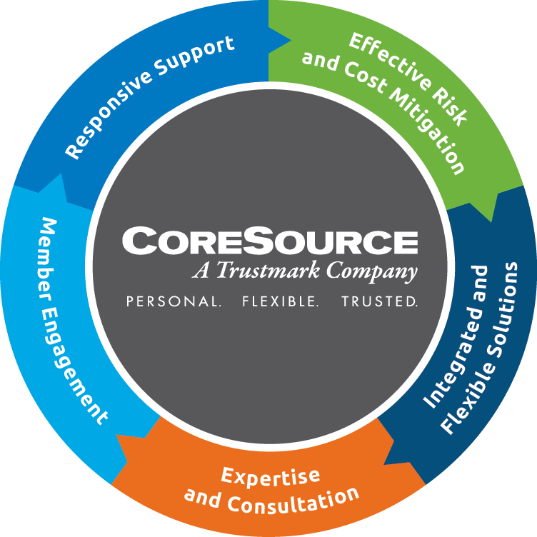
Personal, timely and effective
Proven to save money for clients and employees
Tools and programs improve member health and well-being
Comprehensive, flexible and tailored for unique needs
Expect More. Benefit More.
Data transparency driving insights for informed decision making
Notes:
Present value proposition.

Slide 14
Focus on: Member Engagement

Slide 15
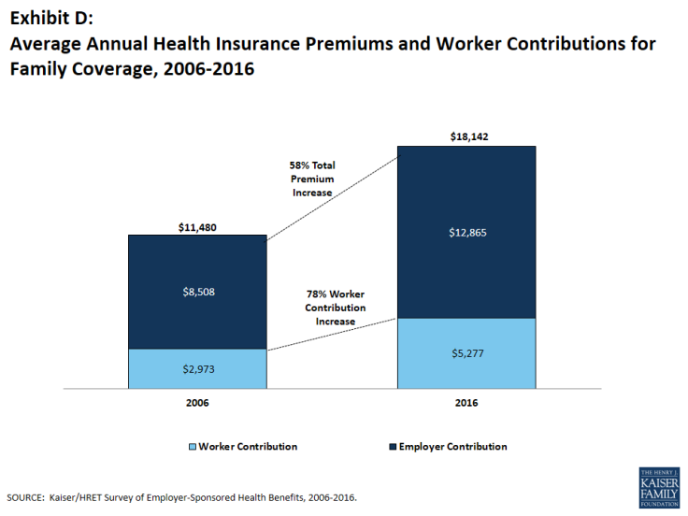
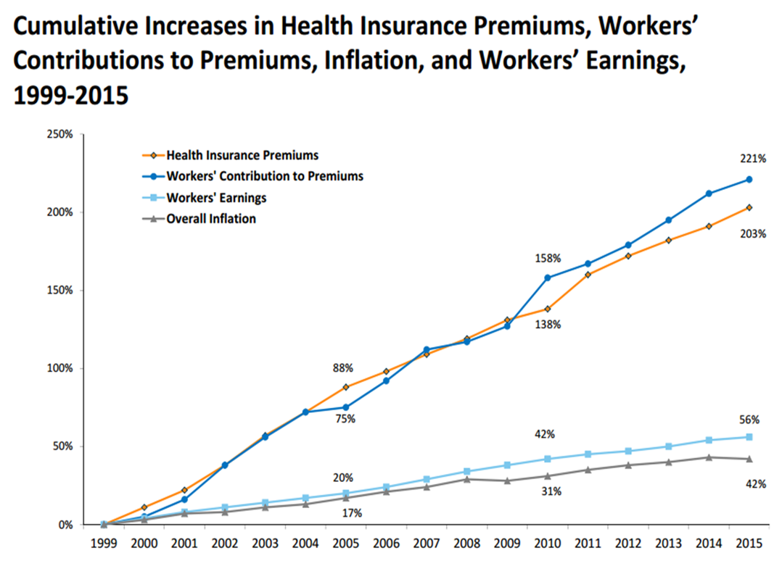
Clients and Their Members Continue to Suffer

Slide 16
Consumers are Worried and Uninformed
Affordability^{1,2}
Confusion³
45% of Americans say it would be difficult to pay an unexpected $500 medical bill
27% say they or a family member delayed getting needed care due to costs
2 of the top 4 American financial worries are about healthcare cost
32% of consumers are uncomfortable with their knowledge of benefits and healthcare
34% understand “co-insurance”
55% understand “max out-of-pocket expense”
1 Kaiser Family Foundation , 2017; 2 Gallop, 2016, 3 The Washington Post, 2013

Slide 17
CoreSource believes we need to begin with better member engagement
Digital connection to: understand benefits, use available resources and make smart healthcare decisions
Consumers don’t know the total cost of care prior to service. Ex. Focus members on quality, low cost in-network providers.
Consumers receive multiple bills from multiple providers yet don’t understand what they owe. Ex. Simplify their bills and make it easy for them to pay.

Slide 18
Better Connected. More Engaged.
CoreSource’s digital communication tools can help reduce members’ anxiety about financial risk from healthcare and the complexity of what they need to understand—we help them feel smart, informed, and confident.
myCoreSourceWire
While employees aren’t thinking about their benefits, we are. The Wire sends convenient messages and guidance to members’ mobile phones.
myCoreSource Mobile App
Allows members quick and convenient access to ID cards, claims, customer service, and more.
myCoreSource Online Portal
Gives members online self-service of their benefits and plan resources anytime.

Slide 19

Relevant Channel
Proven Benefits
33% channel connections
90% more app downloads
130% more portal registrations
30% reduction in ER visits
1.6X likely for cancer screen
16% decrease in brand Rx
200% more likely to pay a bill
45% reduction in calls
CoreSource: Tap to complete
your connection:
https://relayit.com/12erski23.
Txt help or stop.
Msg&DataRatesMayApply.
Sent via Relay.
Welcome to the CoreSource Wire. Here you can find
Important information about your account as well as quick links to make it easy to get stuff done.
CONNECT
WELCOME

Slide 20


Slide 21
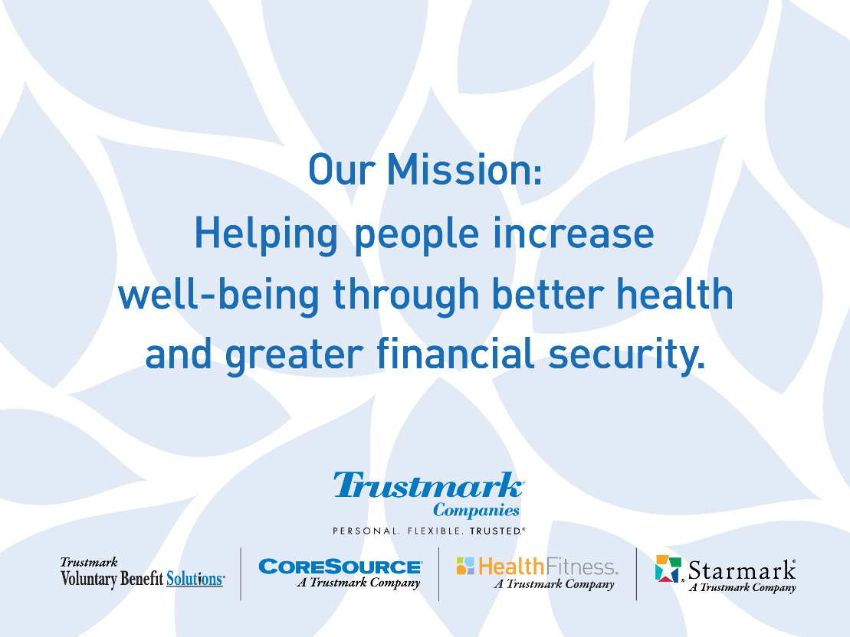



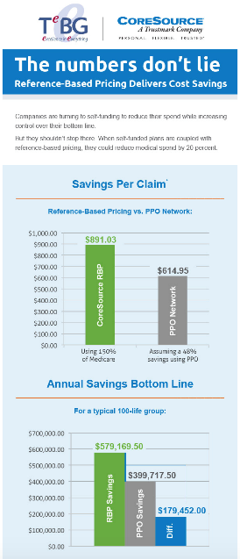
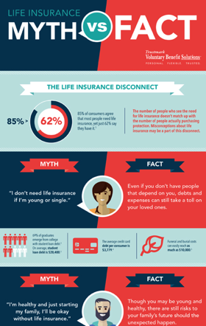




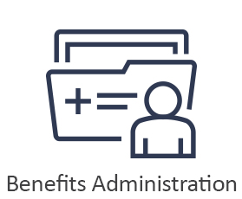
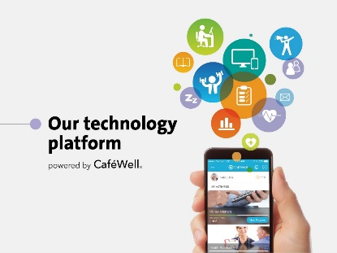
Leveraging Trustmark
Technology to drive results and make things quicker and easier.
Complete creative services to build custom campaigns.
Proprietary market research to support your sales success.
Why Trustmark?
Solutions based
The right combination of capabilities
Resources for your success
We understand our “Why?”
Health & Wellbeing
Self-funded Benefit Administration
Of employees believe that financial health is part of their overall health and wellbeing
Solutions not products. We work with you to help employers solve complex employee benefits challenges.
Of employees say a benefit package with both medical and voluntary means they matter to their employer
Notes:
Closing sequence:
Why Trustmark?
Because, like you, we listen to understand what needed, then offer solutions rather than a list of products.
Because we have the right combination of capabilities to seamlessly serve the unique needs of middle market and larger employers.
Because we provide technology solutions, such as reports, apps that link directly to vital benefit information, a wellness platform that supports each employee’s personal path to wellbeing, and more.
Because we conduct proprietary consumer research and share our insights with you to help bridge the gap between what employers think their employees want and what they really want out of their benefit plan.
Because we offer complete marketing support to drive engagement and help your clients sustain a destination workplace.
Because, like you, we understand not just how and what, but why we’re in business – and shared mission to increase wellbeing through better health and greater financial security.

Slide 22

Thank you!

