Slide 1
Trustmark Paycheck Protect® Insurance
Introducing your special benefits…
Preserving your active lifestyle, whatever may happen.
Trustmark Paycheck Protect® and Trustmark® are registered trademarks of Trustmark Insurance Company.
Notes:
[For ALL cases.]

Slide 2
Why Paycheck Protect?
Keep on living & enjoying your best life.
Meet Charlie!
Charlie works for a hospital. He’s a husband, a dad of two and a pretty active guy.
He’s all about family activities and adventures – and on his own time, he also likes waterskiing, driving his favorite car and playing in his work softball league.
Notes:
[For ALL cases.]

Slide 3
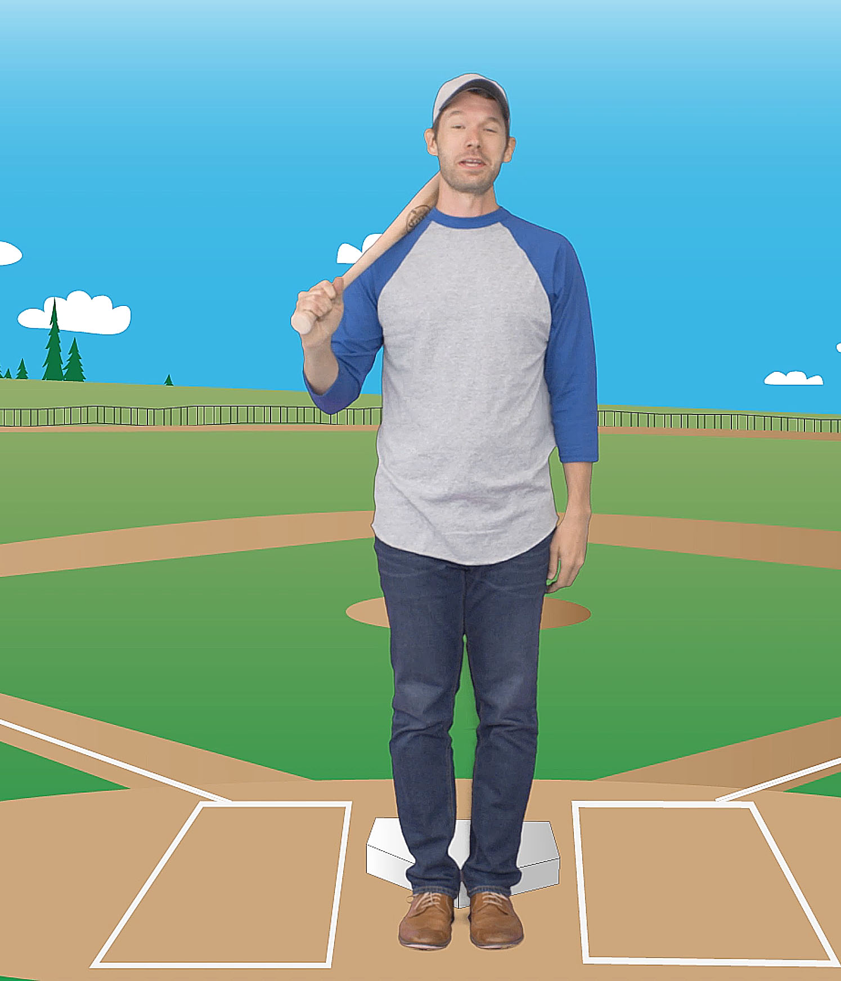
Why Paycheck Protect?
Keep on living & enjoying your best life.
All the stuff that Charlie enjoys doing depends on one very important factor – his paycheck.
Charlie’s income lets him keep up his full, active lifestyle. He’d like to make sure that the unexpected won’t change that lifestyle.
That’s why Charlie insures his livability with Paycheck Protect insurance from Trustmark.
Notes:
[For ALL cases.]

Slide 4
Why Paycheck Protect?
Keep on living & enjoying your best life.
With Paycheck Protect, Charlie knows that his family’s way of life is more safe.
Even if Charlie can’t work for a while due to a covered accident or sickness, Paycheck Protect will kick in and replace part of his income with cash.
So either way, with Paycheck Protect from Trustmark, Charlie and the people who count on him can keep on living and doing what they love.
Notes:
[For ALL cases.]

Slide 5
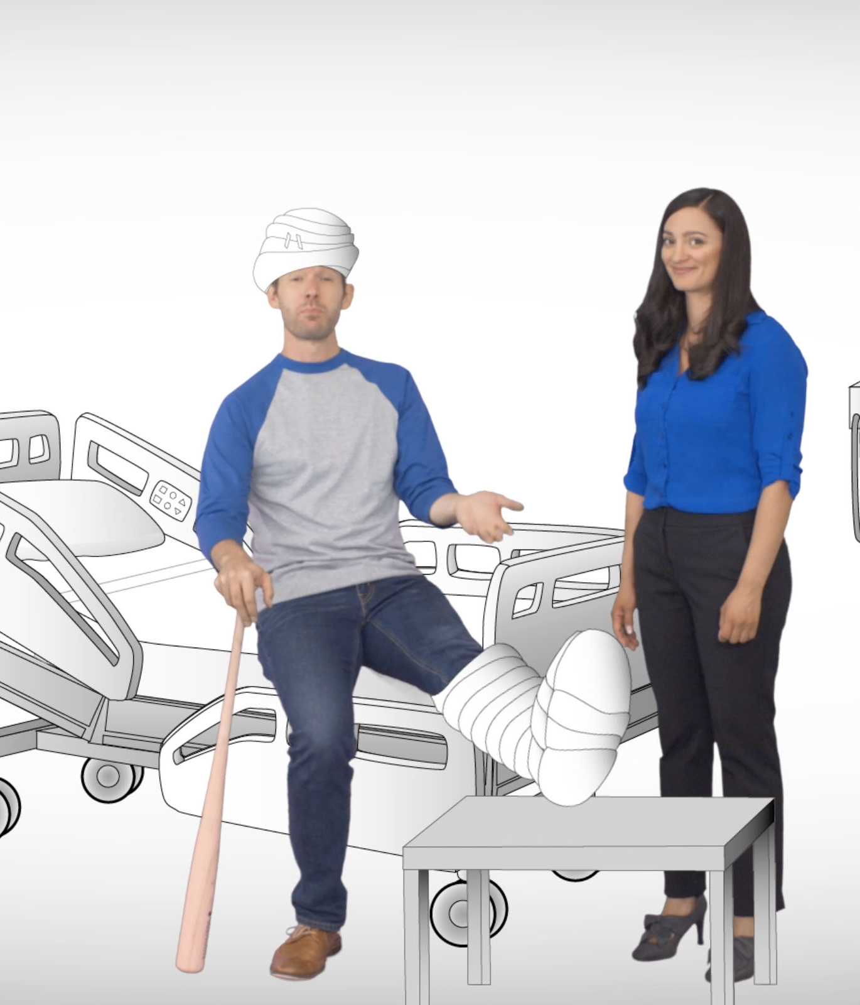
What You’re Covered For
Benefits that matter.
Sickness or injury not occurring at, nor caused by, your job.
Image to come
Some state coverage may differ from the above.
Notes:
[For cases WITHOUT On-the-Job Coverage.]

Slide 6
What You’re Covered For
Benefits that matter.
Sickness or injury not occurring at, nor caused by, your job.
Complications of pregnancy.
Image to come
Some state coverage may differ from the above.
Notes:
[For cases WITHOUT On-the-Job Coverage.]

Slide 7
What You’re Covered For
Benefits that matter.
Sickness or injury not occurring at, nor caused by, your job.
Complications of pregnancy.
Maternity (6-8 weeks of benefits after delivery, 10 months after effective date).
Image to come
Some state coverage may differ from the above.
Maternity benefit duration varies by delivery type.
Notes:
[For cases WITHOUT On-the-Job Coverage and WITH maternity coverage WITH the standard 10-month exclusion.]

Slide 8
What You’re Covered For
Benefits that matter.
Sickness or injury not occurring at, nor caused by, your job.
Complications of pregnancy.
Maternity (6-8 weeks of benefits after delivery).
Image to come
Some state coverage may differ from the above.
Maternity benefit duration varies by delivery type.
Notes:
[For cases WITHOUT On-the-Job Coverage and WITH maternity coverage with the 10-month exclusion WAIVED.]

Slide 9
What You’re Covered For
Benefits that matter.
Sickness or injury.
Image to come
Some state coverage may differ from the above.
Notes:
[For cases with On-the-Job coverage.]

Slide 10
What You’re Covered For
Benefits that matter.
Sickness or injury.
Complications of pregnancy.
Image to come
Some state coverage may differ from the above.
Notes:
[For cases with On-the-Job coverage.]

Slide 11
What You’re Covered For
Benefits that matter.
Sickness or injury.
Complications of pregnancy.
Maternity (6-8 weeks of benefits after delivery, 10 months after effective date).
Image to come
Some state coverage may differ from the above.
Maternity benefit duration varies by delivery type.
Notes:
[For cases with On-the-Job coverage and WITH maternity coverage WITH the standard 10-month exclusion.]

Slide 12
What You’re Covered For
Benefits that matter.
Sickness or injury.
Complications of pregnancy.
Maternity (6-8 weeks of benefits after delivery).
Image to come
Some state coverage may differ from the above.
Maternity benefit duration varies by delivery type.
Notes:
[For cases with On-the-Job Coverage and WITH maternity coverage with the 10-month exclusion WAIVED.]

Slide 13
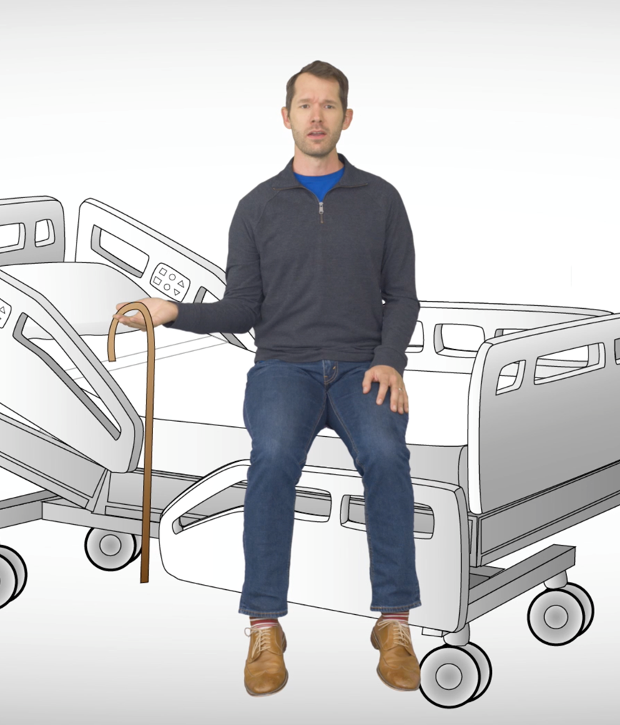
What You’re Covered For
More benefits that matter.
Mental illness.
Treatment for substance abuse
Image to come
In NY, mental illness coverage is mental disorder coverage.
Notes:
[For cases with BOTH mental illness and substance abuse coverage.]

Slide 14
What You’re Covered For
More benefits that matter.
Mental illness
Image to come
In NY, mental illness coverage is mental disorder coverage.
Notes:
[For cases with mental illness coverage but no substance abuse coverage.]

Slide 15
What You’re Covered For
More benefits that matter.
Treatment for substance abuse
Image to come
Notes:
[For cases with substance abuse coverage but no mental illness coverage.]

Slide 16
Additional Features
Extra ways your policy can pay.
A $100 payment will be automatically sent to you every two years that you don’t have a claim – no action required!
An extra one-time $500 payment for each approved claim can help with your bills and “Jump Start” your recovery.
$100
Image to come
$500
Benefits not available in all states.
JumpStart benefit is paid after meeting elimination period or minimum of 14 days total disability, and is not payable with maternity claims.
Notes:
[For cases with BOTH Claim Free Benefit Return and Jump Start riders.]

Slide 17
Additional Features
Extra ways your policy can pay.
$100
A $100 payment will be automatically sent to you every two years that you don’t have a claim – no action required!
Image to come
Benefits not available in all states.
Notes:
[For cases with Claim Free Benefit Return rider but NO Jump Start rider.]

Slide 18
Additional Features
Extra ways your policy can pay.
$500
An extra one-time $500 payment for each approved claim can help with your bills and “Jump Start” your recovery.
Image to come
Benefits not available in all states.
JumpStart benefit is paid after meeting elimination period or minimum of 14 days total disability, and is not payable with maternity claims.
Notes:
[For cases with Jump Start rider but NO Claim Free Benefit Return rider.]

Slide 19
Example of Benefits
$1,000/month policy, 2 ½ months unable to work,
following elimination period:
First month | $1,000
Second month | $1,000
Last 15 days | $500
Total benefits paid: | $2,500
Benefits paid may vary. See your policy/certificate for details.
Notes:
[For cases with NO Jump Start rider.]

Slide 20
Example of Benefits
$1,000/month policy, 2 ½ months unable to work,
following elimination period:
First month (with Jump Start) | $1,500
Second month | $1,000
Last 15 days | $500
Total benefits paid: | $3,000
Benefits paid may vary. See your policy/certificate for details.
Notes:
[For cases WITH Jump Start rider.]

Slide 21
Additional Features
More ways your policy can pay.
PLUS!
If you return to work part-time (<50% of your typical schedule) after total disability for 30 consecutive days, you can receive 50% of your benefit for up to 6 months.*
If your injury/illness occurred on the job and is covered by worker’s compensation, you can still collect 25% of your benefit in addition to any worker’s comp.
*Or what’s left of your maximum benefit period, whichever is less.
Benefits not available in all states.
Notes:
[For cases with BOTH Partial Disability and On-the-Job coverage.]

Slide 22
Additional Features
More ways your policy can pay.
PLUS!
If you return to work part-time (<50% of your typical schedule) after total disability for 30 consecutive days, you can receive 50% of your benefit for up to 6 months or what’s left of your maximum benefit period, whichever is less.
Notes:
[For cases with Partial Disability but NO On-the-Job coverage.]

Slide 23
Additional Features
More ways your policy can pay.
PLUS!
If your injury/illness occurred on the job and is covered by worker’s compensation, you can still collect 25% of your benefit in addition to any worker’s comp.
Benefits not available in all states.
Notes:
[For cases with On-the-Job Coverage but NO Partial Disability.]

Slide 24
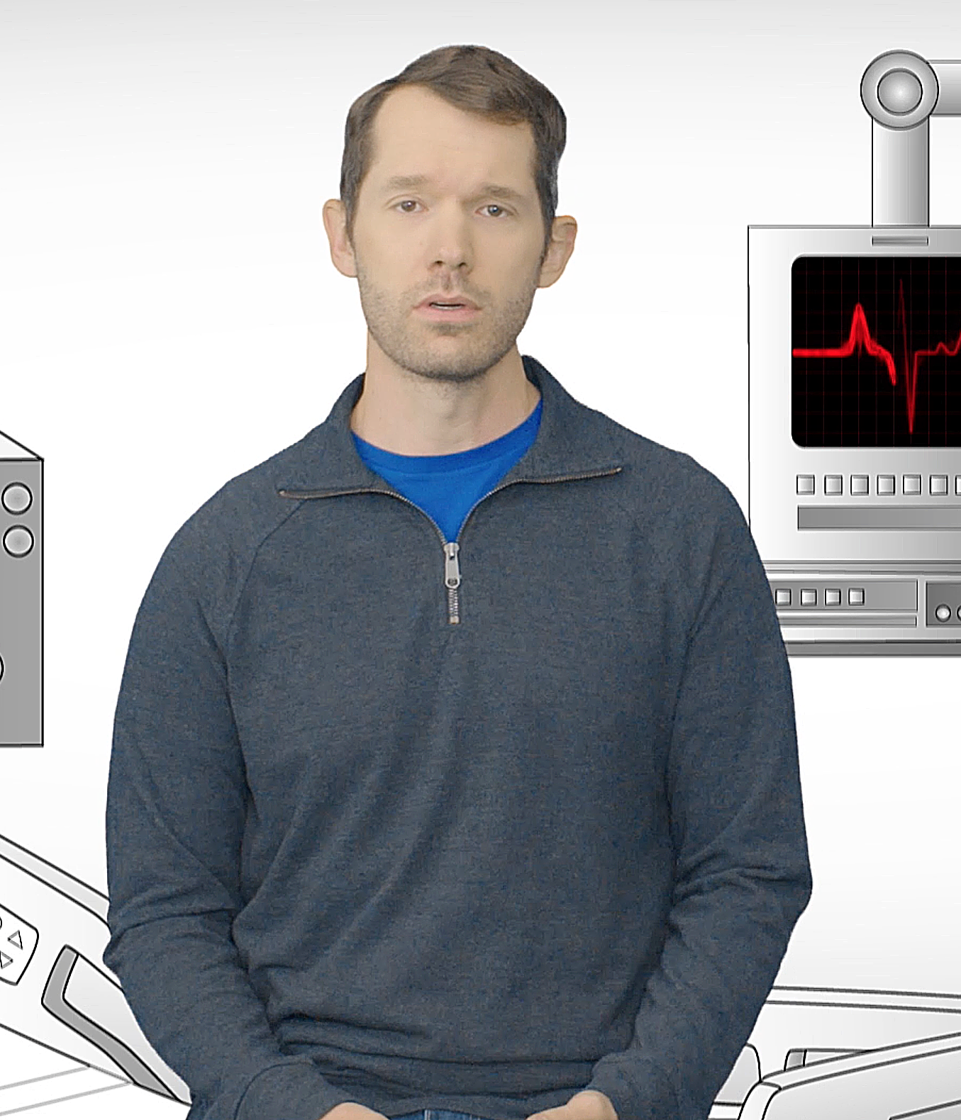
Benefit Payments
When your benefits kick in.
Paycheck Protect insurance pays benefits for total disability, meaning you are:
Unable to work in your regular occupation and not working for profit. (After one year of disability, unable to work at any job for which you are qualified.)
Under a doctor’s care for the injury or covered sickness causing your disability.
Your maximum benefit period is the length of time for which you are able to collect benefits. There may be a period after you become unable to work before your benefits begin, known as the elimination period.
Notes:
[For ALL cases.]

Slide 25
Trustmark Advantage
Benefits are simple – and you own them
As a Trustmark Paycheck Protect policyholder, you enjoy several additional advantages:
● Your rate will never increase (and coverage will never decrease) due to age.
● Your payments are deducted out of your paycheck – no bills to remember or deal with.
● You can keep your coverage at the same price and benefits, even if you change jobs or retire – you can pay by direct bill, automatic deduction or with a credit card. Coverage ends at age 70, or after 5 years if you purchase after age 65.
Notes:
[For ALL cases.]

Slide 26
Any
questions?
Trustmark Paycheck Protect® insurance underwritten by Trustmark Insurance Company, Lake Forest, Illinois.
This is a brief description of benefits under DI 516 and applicable riders CFR 516 and JSB 516. This insurance policy/group certificate provides coverage for disabilities resulting from covered accidents or covered sicknesses. It is not a substitute for medical expense insurance, major medical expense insurance or a health benefit plan alternative. It is also not a Medicare Supplement policy, nor is it a policy of worker’s compensation. Please refer to your policy/group certificate and outline of coverage, if applicable, for complete information. Limitations on pre-existing conditions may apply. A waiting period may apply before benefits are payable. Benefits, definitions, exclusions, form numbers and limitations may vary by state. For costs and coverage detail, including exclusions, limitations and terms, see your agent or write the company. Underwriting conditions may vary, and determine eligibility for the offer of insurance. For exclusions and limitations that may apply, visit www.trustmarksolutions.com/disclosures/P2/.
A112-2326
Notes:
[For ALL cases.]

