Slide 1
Introducing your special benefits…
Trustmark
Critical HealthEventsSM Insurance
Critical illness insurance that offers a lifetime of benefits.
Trustmark Critical HealthEventsSM is a trademark of Trustmark Insurance Company
Trustmark® is a registered trademark of Trustmark Insurance Company.
Notes:
[For ALL cases.]

Slide 2
Why Critical HealthEvents?
Major illnesses come with hidden costs.
Meet Charlie!
Hospital employee. Husband. Dad of two. All-around fairly normal, average guy, enjoying his life.
He’s in pretty good health. But he knows that could suddenly change. After all, normal, average guys like him face major illnesses all the time.
Notes:
[For ALL cases.]

Slide 3
Why Critical HealthEvents?
Major illnesses come with hidden costs.
Charlie has health insurance. But if he were to face a health crisis – like cancer, a heart attack or a stroke – that alone probably won’t cover all his costs.
He might have co-pays. Extra bills. He might need home help, or seek additional treatment. Getting sick like that can get expensive, fast.
But Charlie doesn’t need to worry – he’s also got Critical HealthEvents insurance from Trustmark.
Notes:
[For cases that include cancer coverage.]

Slide 4
Why Critical HealthEvents?
Major illnesses come with hidden costs.
Charlie has health insurance. But if he were to face a health crisis – like a heart attack or a stroke – that alone probably won’t cover all his costs.
He might have co-pays. Extra bills. He might need home help, or seek additional treatment. Getting sick like that can get expensive, fast.
But Charlie doesn’t need to worry – he’s also got Critical HealthEvents insurance from Trustmark.
Notes:
[For cases that DO NOT include cancer coverage.]

Slide 5
Why Critical HealthEvents?
Major illnesses come with hidden costs.
Trustmark’s Critical HealthEvents pays cash benefits directly to you when you’re diagnosed with a covered condition.
You can use those benefits for whatever you need, letting you focus on recovering and getting well.
So just like Charlie, with Critical HealthEvents you can rest easy knowing that a covered critical illness won’t bust your budget.
Notes:
[For ALL cases.]

Slide 6
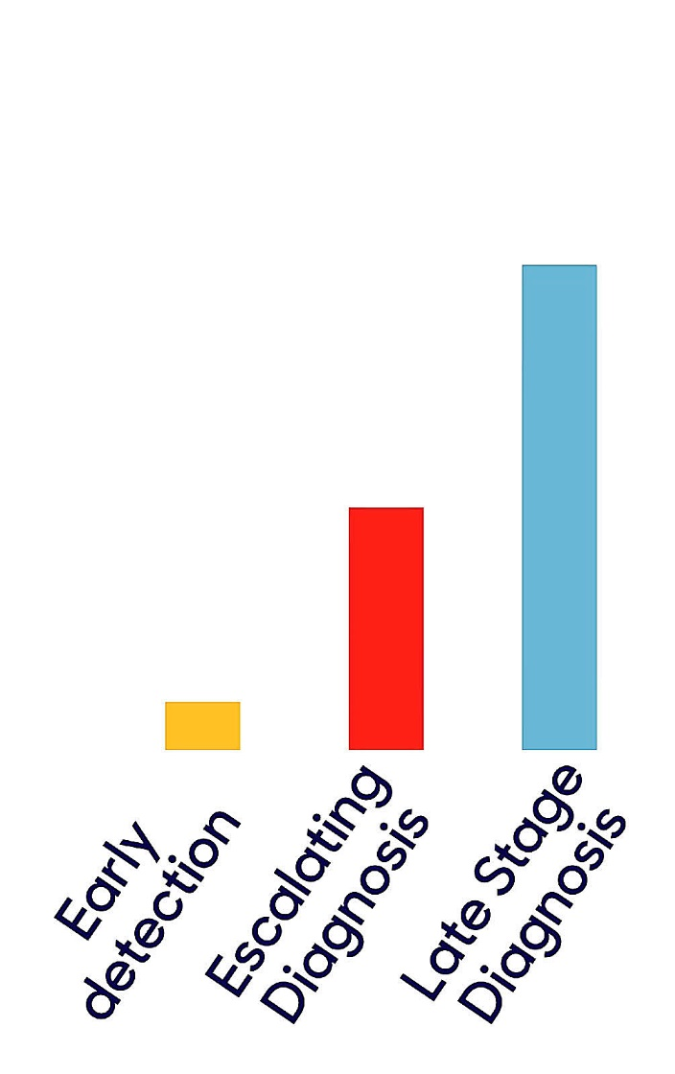
Triple Protection for Critical Illness
Critical HealthEvents is uniquely designed to help you manage critical illness!
1. It pays for early diagnosis of covered illness as well as for late-stage diagnosis. Early benefits and treatments can help you preserve your health.
2. It features a benefit that replenishes annually with no lifetime maximum. This means even if you collect 100% of your benefit in one year, your policy will still be there in full the next year for a new diagnosis.
3. It’s affordable, because it focuses on the critical-illness conditions most likely to happen: cancer, heart attack, and stroke.
Depending on diagnosis and stage, payments may be 100%, 50% or 10% of selected benefit amount. Policy/certificate will contain full list of covered conditions.
Notes:
[For cases that include cancer coverage.]

Slide 7
Triple Protection for Critical Illness
Critical HealthEvents is uniquely designed to help you manage critical illness!
1. It pays for early diagnosis of covered illness as well as for late-stage diagnosis. Early benefits and treatments can help you preserve your health.
2. It features a benefit that replenishes annually with no lifetime maximum. This means even if you collect 100% of your benefit in one year, your policy will still be there in full the next year for a new diagnosis.
3. It’s affordable, because it focuses on critical-illness conditions very likely to happen to someone: heart attack and stroke.
Depending on diagnosis and stage, payments may be 100%, 50% or 10% of selected benefit amount. Policy/certificate will contain full list of covered conditions.
Notes:
[For cases that DO NOT include cancer coverage.]

Slide 8
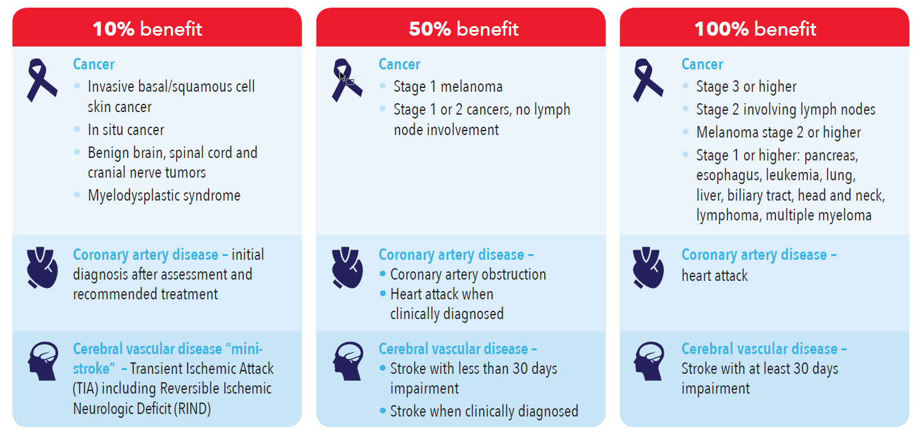
How Critical HealthEvents Benefits Are Paid
A 30-day waiting period may apply before benefits are payable. Payouts per year will not exceed your annual maximum. Benefits differ in the state of New York. Your policy/group certificate will contain specific covered illness and details, including a complete description of benefit provisions, exclusions and limitations.
Notes:
[For all cases that include cancer coverage.]

Slide 9
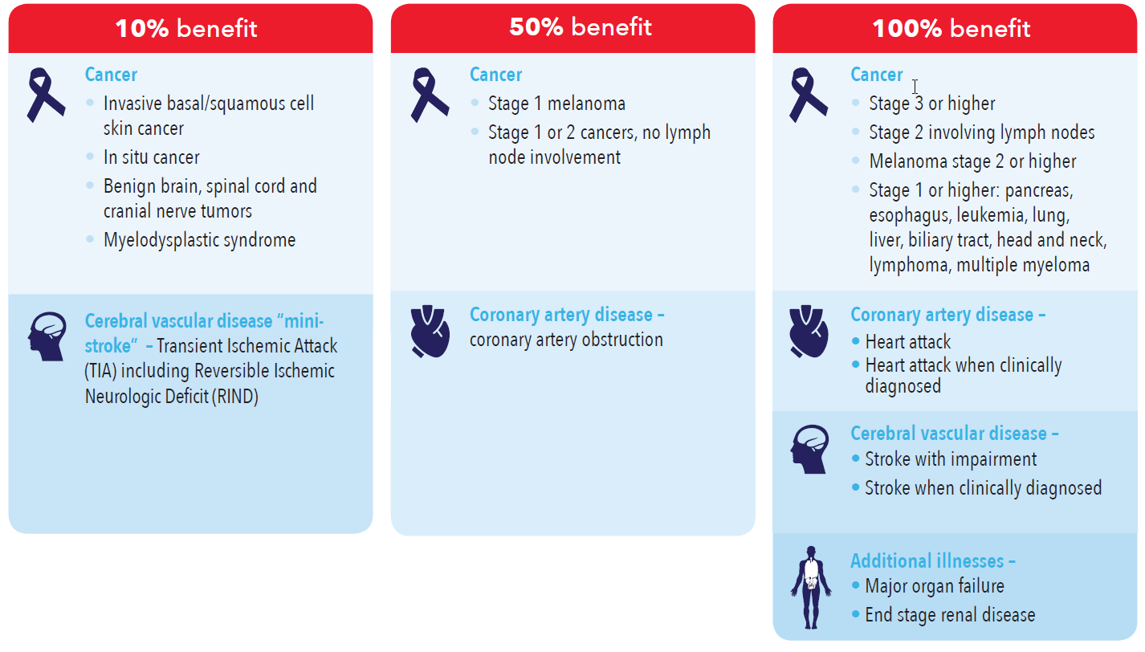
How Critical HealthEvents Benefits Are Paid (NY)
A 30-day waiting period may apply before benefits are payable. Payouts per year will not exceed your annual maximum. Your policy/group certificate will contain specific covered illness and details, including a complete description of benefit provisions, exclusions and limitations.
Notes:
[For all cases that include cancer coverage AND have coverage in the state of New York.]

Slide 10
How Critical HealthEvents Benefits Are Paid
A 30-day waiting period may apply before benefits are payable. Payouts per year will not exceed your annual maximum. Benefits differ in the state of New York. Your policy/group certificate will contain specific covered illness and details, including a complete description of benefit provisions, exclusions and limitations.
Notes:
[For all cases that DO NOT include cancer coverage.]

Slide 11
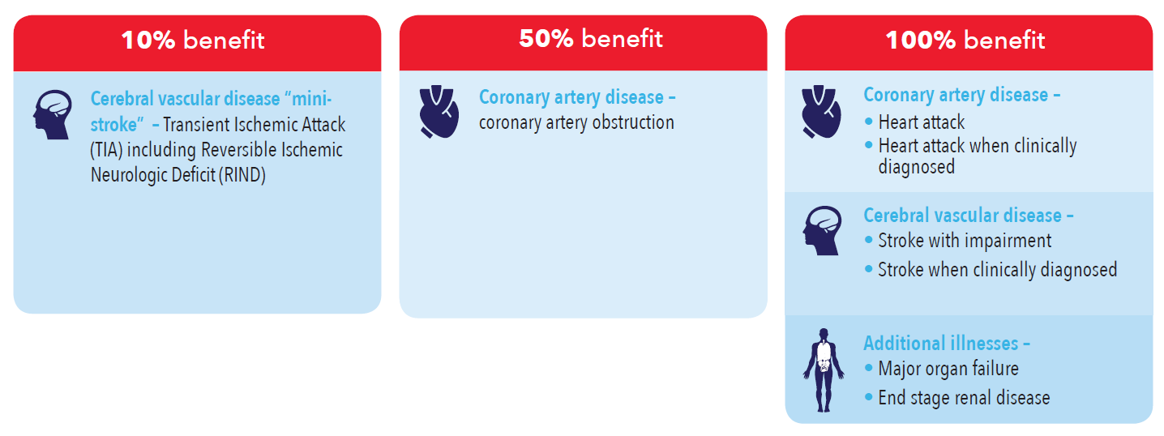
How Critical HealthEvents Benefits Are Paid (NY)
A 30-day waiting period may apply before benefits are payable. Payouts per year will not exceed your annual maximum. Your policy/group certificate will contain specific covered illness and details, including a complete description of benefit provisions, exclusions and limitations.
Notes:
[For all cases that DO NOT include cancer coverage and have coverage in the state of New York.]

Slide 12
Benefit Fully Restores Every Year!
A lifetime of protection – even after a claim.
Critical HealthEvents is designed to provide a lifetime of benefits. No matter how much of your benefit amount you collect in one year, the full amount is available next year, with no lifetime maximum!
Example of a restoring benefit:
Notes:
[For ALL cases.]

Slide 13
Additional Benefits
Your policy may also include:
$50 Healthy Living Rider
Helps protect your health by providing $50 annually for one routine service for early detection and prevention, plus another $50 for a follow-up diagnostic test. Benefits for additional tests may also be available.
A benefit representative can provide a list of covered tests. Your policy will also contain complete details.
Notes:
[For cases with a $50 Healthy Living Rider.]

Slide 14
Additional Benefits
Your policy may also include:
$75 Healthy Living Rider
Helps protect your health by providing $75 annually for one routine service for early detection and prevention, plus another $75 for a follow-up diagnostic test. Benefits for additional tests may also be available.
A benefit representative can provide a list of covered tests. Your policy will also contain complete details.
Notes:
[For cases with a $75 Healthy Living Rider.]

Slide 15
Additional Benefits
Your policy may also include:
$100 Healthy Living Rider
Helps protect your health by providing $100 annually for one routine service for early detection and prevention, plus another $100 for a follow-up diagnostic test. Benefits for additional tests may also be available.
A benefit representative can provide a list of covered tests. Your policy will also contain complete details.
Notes:
[For cases with a $100 Healthy Living Rider.]

Slide 16
Additional Benefits
Your policy may also include:
Caregiver Rider
Provides an annual benefit when an insured person provides care to an eligible family member diagnosed with a covered illness.
Pays one benefit per year, up to three payments, during the life of your policy. Only one covered person can receive a benefit for the same family member.
Benefit not available in all states.
Notes:
[For cases with the Caregiver Rider.]

Slide 17
Additional Benefits
Your policy may also include:
Additional Sickness Rider
Provides additional cash benefits when you cannot perform two activities of daily living (ADLs) due to sickness for at least 90 continuous days.
Benefit not available in all states.
Notes:
[For cases with the Additional Sickness rider.]

Slide 18
Additional Benefits
Your policy may also include:
Specified Illness Rider
Provides a benefit at 10%, 50% or 100% of the annual maximum once per lifetime per condition, for additional covered illnesses, including:
Permanent blindness
Complications of diabetes
Irreversible loss of hearing
Paralysis due to sickness
Organ failure
Central nervous conditions
Stem cell/bone marrow transplant
Benefit paid is subject to the annual maximum.
See policy/certificate for full list of covered conditions.
Benefit not available in all states.
Notes:
[For cases with the Specified Illness Rider.]

Slide 19
Additional Benefits
Your policy may also include:
Waiver of Premium for Disability
Waives premiums for all covered persons when you become totally disabled.
Benefit not available in all states.
Notes:
[For cases with the Waiver of Premium for Disability rider.]

Slide 20
Additional Benefits
Your policy may also include:
Waiver of Premium After Benefit Payout
Waives premiums for all covered persons for six months after you receive a benefit at the 50% or 100% level.
Notes:
[For cases with the Waiver of Premium after Benefit Payout rider.]

Slide 21
Plus: EZ Value
Increase your benefit over time.
Charlie’s need for financial protection is likely to increase over time.
The EZ Value option can automatically increase his benefit amount over time – without any medical questions.
Example: $1 increase in weekly
rate each year, for 5 years:
$39,590
$25,554
$15,000
After 5 years
Initial benefit
After 3 years
Example is for age 40, employee only, non-tobacco coverage, including coverage for cancer, with no additional features. Actual values will vary by age, tobacco status and benefits selected by you or by your employer.
Notes:
[For cases with an EZ Value option.]

Slide 22
Family Coverage
Apply for family members, too!
Charlie isn’t the only one in his household who would benefit from financial protection.
He can also apply for coverage for his spouse, children and dependent grandchildren.
Notes:
[For all cases with family coverage options.]

Slide 23
Trustmark Advantage
Benefits are simple – and you own them.
As a Trustmark Critical HealthEventsSM policyholder, you enjoy several additional advantages:
● Your rate will never increase (and coverage will never decrease) due to age.
● Your payments are deducted out of your paycheck – no bills to remember or deal with.
● You can keep your coverage at the same price and benefits, even if you change jobs or retire – you can pay by direct bill, automatic deduction or with a credit card.
Notes:
[For ALL cases.]

Slide 24
Limitations and Exclusions: AZ Residents
No benefits will be paid for any of the following:
• A diagnosis made prior to the Effective Date or during the Waiting Period as applicable to the Covered Person
• Non-invasive squamous cell and basal cell skin cancers*
• Premalignant conditions and polyps*
• Attacks of Vertebrobasilar Ischemia
• Any condition not listed explicitly in the Schedule of Benefits
• Any Illness resulting from the Covered Person’s:
• Use of alcohol, drugs, narcotics, or hallucinogens not prescribed by a Physician, or not used in the manner prescribed by the Physician
• Commission of or attempt to commit a felony
• Engagement in an illegal occupation
• Involvement in a war or act of war, declared or undeclared
• Participation in a riot
[Pre-Existing Condition Limitation
No benefit will be paid for any condition caused by or resulting from a Pre-existing Condition which begins in the first 12 months after the Covered Person’s coverage Effective Date.]
*Cancer and cancer-related conditions are not covered conditions with all Critical HealthEventsSM plans. See your policy/certificate for complete details.
Notes:
[For all cases that are at least partially in the state of AZ.]

Slide 25
Any
questions?
Trustmark Critical HealthEventsSM insurance is underwritten by Trustmark Insurance Company, Lake Forest, Illinois.
This is a brief description of benefits under CII 214 and applicable riders SIR 214, ASR 214, HLR 214, CGR 214, WPD 214, WPC 214, MAR 214, and EZV 214. This critical illness/specified disease insurance policy/group certificate provides supplemental health insurance coverage, which pays a limited, lump-sum benefit for specified diseases only. It is not a substitute for medical expense insurance, major medical expense insurance or a health benefit plan alternative. It does not provide comprehensive medical coverage. It is not intended to pay all medical costs associated with the specified diseases and is not designed to provide coverage for other medical conditions or illnesses. It is also not a Medicare Supplement policy, nor is it a policy of worker’s compensation. Please refer to your policy/group certificate and outline of coverage, if applicable, for complete information. Limitations on pre-existing conditions may apply. Benefits, definitions, exclusions, form numbers and limitations may vary by state. For costs and coverage detail, including exclusions, limitations and terms, see your agent or write the company. Underwriting conditions may vary, and determine eligibility for the offer of insurance. For exclusions and limitations that may apply, visit www.trustmarksolutions.com/disclosures/CHE/ (A112-2216-CHE).
A112-2327
Notes:
[For ALL cases.]

