Slide 1
Introducing your special benefits…
Trustmark Accident Insurance
Coverage for when life takes a tumble.
Trustmark® is a registered trademark of Trustmark Insurance Company.
Notes:
[For ALL cases.]

Slide 2
Why Accident Insurance?
Cash benefits to help with injuries.
Meet Charlie!
He’s a 37-year-old hospital employee and dad who plays in his work’s softball league.
His two kids and his spouse come to watch him play sometimes – and that means he tries extra hard to impress them.
Notes:
[For ALL cases.]

Slide 3
Why Accident Insurance?
Cash benefits to help with injuries.
Unfortunately, while making the game-winning slide into home plate, something went wrong and Charlie badly broke his leg!
An ambulance was called to take Charlie to a hospital, where he had the fracture surgically fixed and spent the night. Later, there would be a follow-up doctor’s visit, crutches and physical therapy. Charlie’s health insurance covered some of the costs, but not everything.
But Charlie never had to worry – because he also has Accident insurance from Trustmark.
26
Notes:
[For ALL cases.]

Slide 4
Why Accident Insurance?
Cash benefits to help with injuries.
Charlie’s Accident insurance paid cash benefits directly to him for his troubles.
He got a payment for the broken leg. Another for the ambulance. Another for his hospital admission, and so on. All of his payments came regardless of what his medical insurance paid for his treatment.
Charlie used that money towards his co-pays and deductibles… and also towards some new, safer softball cleats! All thanks to his Trustmark Accident insurance policy.
Notes:
[For ALL cases.]

Slide 5
Benefits for Injury/Care
What does Accident insurance cover?
Accident insurance pays benefits for both covered injuries and medical services, including (but not limited to):
Medical services:
Covered injuries:
Hospital admissions
Ambulance transport
Physical therapy
Prosthetic devices or artificial limbs
Follow-up treatment
Fractures
Dislocations
Burns
Concussion
Lacerations
These are just examples. A complete schedule of benefits will be listed in your policy.
Notes:
[For ALL cases.]

Slide 6
How Charlie’s Accident Insurance Might Pay
One example of benefit payouts for a broken leg.
Injury/Service | Payout
Fracture (open) | $1,600
Ambulance (ground) | $100
Emergency room treatment | $150
Hospital admission benefit | $1,000
Appliance (crutches) | $100
Follow-up doctor’s visit | $50
Three (3) physical therapy appointments | $75
TOTAL: | $3,075
This is just one example; your plan may differ. Charlie lives in Illinois and has the Trustmark Accident plan offered by his employer. Benefits differ by plan and by state. Talk to a benefits representative or see your policy/certificate for your own schedule of benefits.
Notes:
[For ALL cases.]

Slide 7
24-Hour Coverage
Your Accident insurance policy.
Accident insurance offers 24-hour coverage, meaning your injuries are covered whether or not you are at work when they occur!
These benefits are paid independently of any worker’s compensation.
Notes:
[For cases with 24-hour coverage.]

Slide 8
Off-the-Job Coverage
Your Accident insurance policy.
Accident insurance pays benefits for injuries and treatment for non-work-related accidental injuries.
Notes:
[For cases with non-occupational coverage.]

Slide 9
Additional Benefits
Your policy may also include:
Health Screening Benefit Rider
Get paid for certain health screening tests and procedures; for example:
Routine mammogram
Colonoscopy
Prostate-specific antigen (PSA) test
Breast ultrasound
A complete schedule of benefits will be listed in your policy.
Benefit not available in all states.
Notes:
[For cases with Health Screening Benefit Rider.]

Slide 10
Additional Benefits
Your policy may also include:
Wellness Benefit Rider
Get paid for certain health screening tests and procedures; for example:
Routine mammogram
Colonoscopy
Prostate-specific antigen (PSA) test
Routine physical exam
Breast ultrasound
Immunizations
A complete schedule of benefits will be listed in your policy.
Benefit not available in all states.
Notes:
[For cases with Wellness Benefit Rider. CANNOT be used in the state of NM.]

Slide 11
Additional Benefits
Your policy may also include:
Accidental Death Benefit
Receive a lump-sum payment in the event of the death of an insured person by a covered accident.
A complete schedule of benefits will be listed in your policy.
Benefit not available in all states.
Notes:
[For cases with Accidental Death Benefit.]

Slide 12
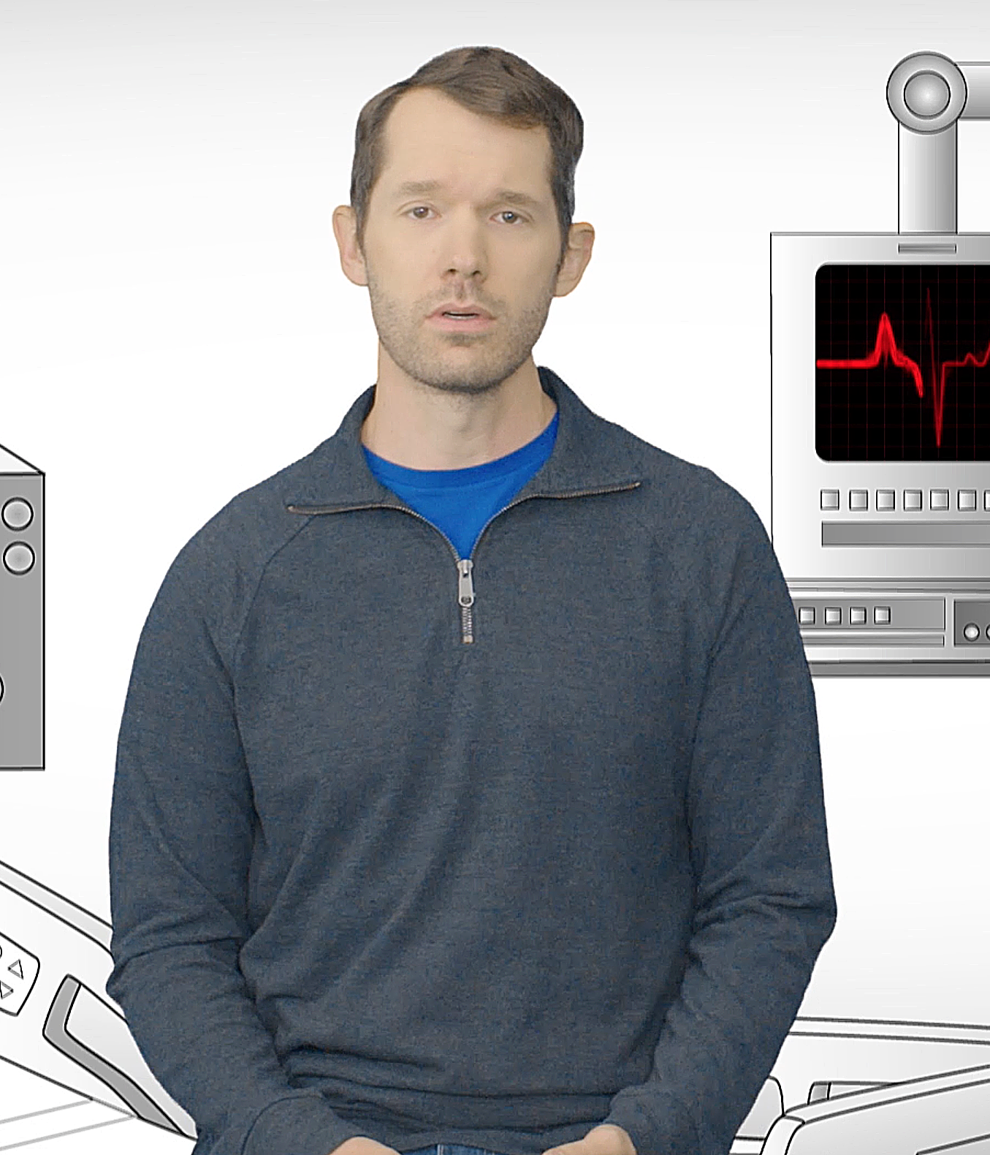
Additional Benefits
Your policy may also include:
Catastrophic Accident Benefit
Receive a lump-sum payment if an insured person completely loses sight, hearing, speech, or the use of two or more limbs in a covered catastrophic accident.
A complete schedule of benefits will be listed in your policy.
Benefit not available in all states.
Notes:
[For cases with Catastrophic Accident Benefit.]

Slide 13
Family Coverage
Apply for family members, too!
Charlie isn’t the only one in his household who would benefit from financial protection.
He can also apply for coverage for his spouse, children and dependent grandchildren.
Accident insurance is great coverage for kids!
More than 3.5 million children and teens in the U.S. experience a sports injury each year.¹ The average cost to treat a broken arm is nearly $7,500.²
¹Johns Hopkins Medicine Health Library, 2024, “Sports Injury Statistics,” hopkinsmedicine.org/health
²US Healthcare.gov, 2024, healthcare.gov/why-coverage-is-important/protection-from-high-medical-costs/
Notes:
[For cases with the option for family coverage.]

Slide 14
Trustmark Advantage
Benefits are simple – and you own them.
As a Trustmark Accident insurance policyholder, you enjoy several additional advantages:
● Your rate will never increase (and coverage will never decrease) due to age.
● Your payments are deducted out of your paycheck – no bills to remember or deal with.
● You can keep your coverage at the same price and benefits, even if you change jobs or retire – you can pay by direct bill, automatic deduction or with a credit card.
Notes:
[For ALL cases.]

Slide 15
Any
questions?
Accident insurance is underwritten by Trustmark Insurance Company, Lake Forest, Illinois.
This is a brief description of benefits under A-607 and applicable riders WB-607, HS-12000R, and LCWP-5/01. This is an accident only policy with limited benefits and does not pay benefits for diseases, sickness, or for loss from sickness. This is not a workers’ compensation policy or a substitute for medical expense insurance, major medical insurance or a health benefit plan alternative. It is also not a Medicare Supplement policy. Please refer to your policy/group certificate and outline of coverage, if applicable, for complete information. Limitations on pre-existing conditions may apply. Benefits, definitions, exclusions, form numbers and limitations may vary by state. For costs and coverage detail, including exclusions, limitations and terms, see your agent or write the company. Underwriting conditions may vary, and determine eligibility for the offer of insurance. For exclusions and limitations that may apply, visit www.trustmarksolutions.com/disclosures/ACC/ (A112-2216-ACC).
A112-2328
Notes:
[For ALL cases.]

