Slide 1
Trustmark Disability Income Insurance
Introducing your special benefits…
Protecting your paycheck even when you can’t work.
Trustmark® is a registered trademark of Trustmark Insurance Company.
Notes:
[For ALL cases.]

Slide 2
Why Disability Insurance?
Keep on living & enjoying your best life.
Meet Charlie!
Charlie works for a hospital. He’s a husband, a dad of two and a pretty active guy.
He’s all about family activities and adventures – and on his own time, he also likes waterskiing, driving his favorite car and playing in his work softball league.
Notes:
[For ALL cases.]

Slide 3
Why Disability Insurance?
Keep on living & enjoying your best life.
All the stuff that Charlie enjoys doing depends on one very important factor – his paycheck.
Charlie’s income lets him keep up his full, active lifestyle. He’d like to make sure that the unexpected won’t change that lifestyle.
That’s why Charlie insures his livability with Disability Income insurance from Trustmark.
Notes:
[For ALL cases.]

Slide 4
Why Disability Insurance?
Keep on living & enjoying your best life.
With Disability Income, Charlie knows that his family’s way of life is more safe.
Even if Charlie can’t work for a while due to a covered accident or sickness, Disability Income will kick in and replace part of his income with cash.
So either way, with Disability Income insurance from Trustmark, Charlie and the people who count on him can keep on living and doing what they love.
Notes:
[For ALL cases.]

Slide 5
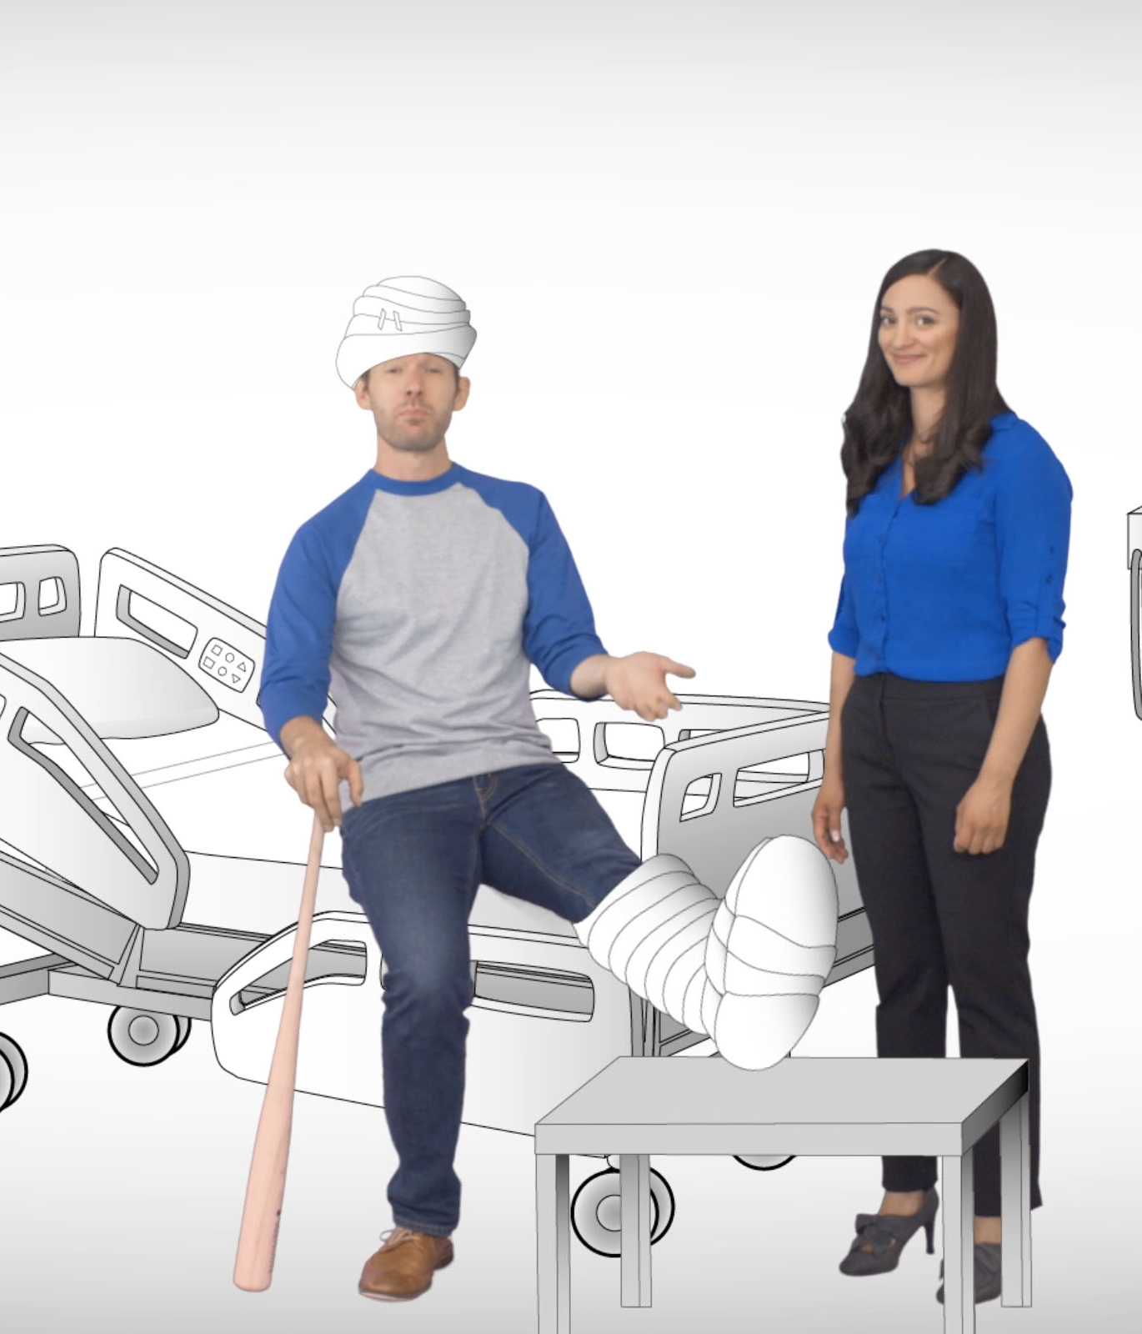
What You’re Covered For
Benefits that matter.
Sickness or injury not occurring at, nor caused by, your job.
Complications of pregnancy.
Maternity (6-8 weeks of benefits after delivery, 10 months after effective date).
Image to come
Some state coverage may differ from the above.
Maternity benefit duration varies by delivery type.
Notes:
[For cases with the standard 10-month exclusion for maternity coverage.]

Slide 6
What You’re Covered For
Benefits that matter.
Sickness or injury not occurring at, nor caused by, your job.
Complications of pregnancy.
Maternity (6-8 weeks of benefits after delivery).
Image to come
Some state coverage may differ from the above.
Maternity benefit duration varies by delivery type.
Notes:
[For cases that WAIVE the standard 10-month exclusion for maternity coverage.]

Slide 7
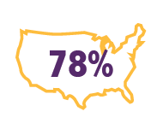
Did You Know?
Everyone needs to protect their paychecks.
1 of 4 20-year-olds will
experience a disability before reaching age 67.*
78% of American workers live paycheck to paycheck to
make ends meet.**
*Social Security Administration, “Disability Planner: Social Security Protection If You Become Disabled.”
**CareerBuilder, “Living Paycheck to Paycheck is a Way of Life for Majority of U.S. Workers, According to New CareerBuilder Survey.”
Notes:
[For ALL cases.]

Slide 8
Example of Benefits
$1,000/month policy, 2 ½ months unable to work,
following elimination period:
First month | $1,000
Second month | $1,000
Last 15 days | $500
Total benefits paid: | $2,500
Benefits paid may vary. See your policy/certificate for details.
Notes:
[For ALL cases.]

Slide 9
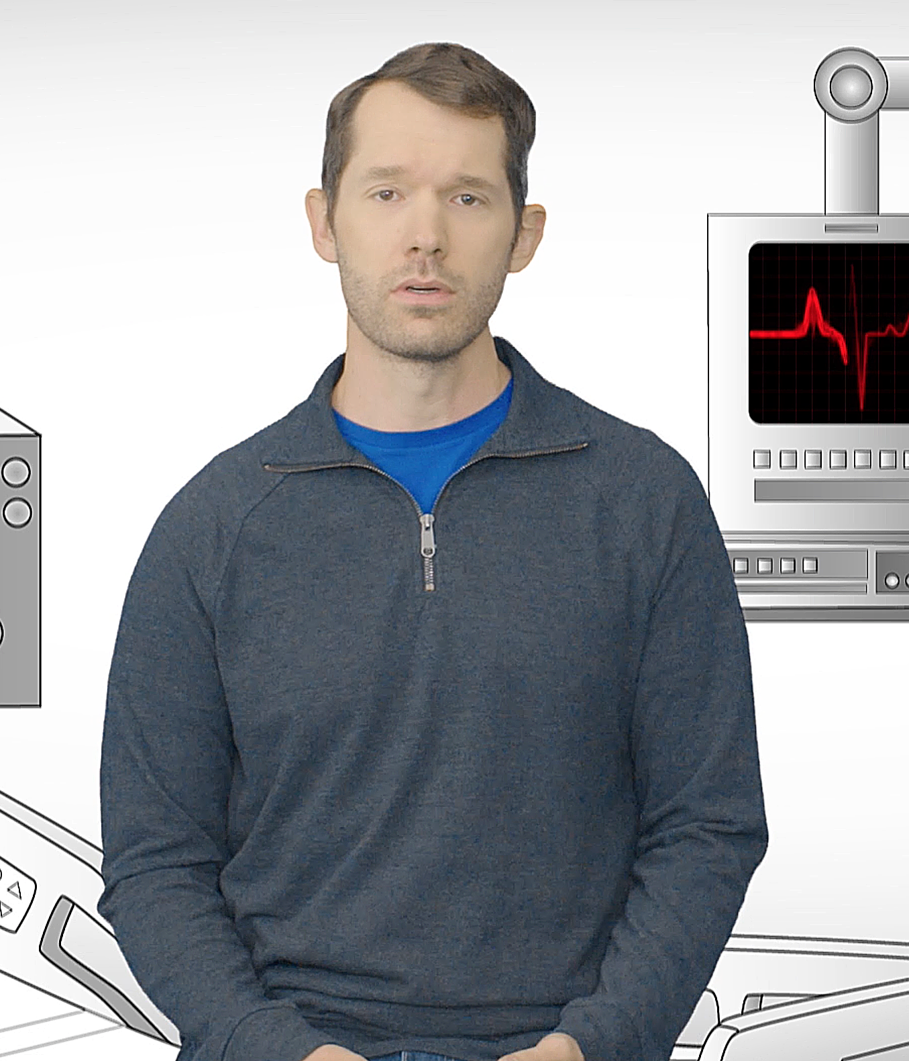
Benefit Payments
When your benefits kick in.
Disability Income insurance pays benefits for total disability, meaning you are:
Unable to work at your job. (After one year of disability, unable to work at any job for which you are qualified.)
Not working at your current employer. (After one year of disability, not working at any gainful job for pay and/or benefits.)
Under a doctor’s care for the injury or covered sickness causing your disability.
Notes:
[For ALL cases.]

Slide 10
Benefit Payments
Coverage and elimination periods
Your maximum benefit period is the length of time for which you are able to collect benefits.
There may be a period after you become unable to work before your benefits begin, known as the elimination period.
Notes:
[For ALL cases.]

Slide 11
Trustmark Advantage
Benefits are simple – and you own them
As a Trustmark Disability policyholder, you enjoy several additional advantages:
● Your rate will never increase (and coverage will never decrease) due to age.
● Payments are conveniently deducted out of your paycheck.
● You can keep your coverage at the same price and benefits, even if you change jobs or retire – you can pay by direct bill, automatic deduction or with a credit card. Coverage ends at age 72.
Notes:
[For ALL cases.]

Slide 12
Any
questions?
Disability Income insurance underwritten by Trustmark Insurance Company, Lake Forest, Illinois.
This is a brief description of benefits under DI-902 and applicable riders. This insurance policy/group certificate provides coverage for disabilities resulting from covered accidents or covered sicknesses. It is not a substitute for medical expense insurance, major medical expense insurance or a health benefit plan alternative. It is also not a Medicare Supplement policy, nor is it a policy of worker’s compensation. Please refer to your policy/group certificate and outline of coverage, if applicable, for complete information. Limitations on pre-existing conditions may apply. A waiting period may apply before benefits are payable. Benefits, definitions, exclusions, form numbers and limitations may vary by state. For costs and coverage detail, including exclusions, limitations and terms, see your agent or write the company. Underwriting conditions may vary, and determine eligibility for the offer of insurance. For exclusions and limitations that may apply, visit www.trustmarksolutions.com/disclosures/DI/ (A112-2216-DI).
A112-2330
Notes:
[For ALL cases.]

