Slide 1
Introducing your special benefits…
Trustmark Hospital StayPay® Insurance
Extra protection against costly hospital bills.
Trustmark® and Trustmark Hospital StayPay® are registered trademarks of Trustmark Insurance Company.
Notes:
[For ALL cases.]

Slide 2

Why Hospital StayPay?
Hospital bills can add up in a hurry.
Meet Charlie!
He’s a 37-year-old living in the suburbs with his wife and two kids, making ends meet for his family. They’re not rich, but they do okay.
Charlie keeps a fairly busy schedule. Sometimes he only has time for a quick snack on the go. Unfortunately, that’s where the trouble started…
Fictional character and story for illustrative purposes.
Notes:
[For ALL cases.]

Slide 3

Why Hospital StayPay?
Hospital bills can add up in a hurry.
A few weeks ago, Charlie’s meal came from the back of the pantry – and he forgot to check the long-past expiration date. Sorry, Charlie: you’ve got food poisoning!
Charlie’s had to spend several days in the hospital.
Thankfully, Charlie fully recovered.
And so could his family’s finances, thanks to his Trustmark Hospital StayPay® policy.
Notes:
[For ALL cases.]

Slide 4
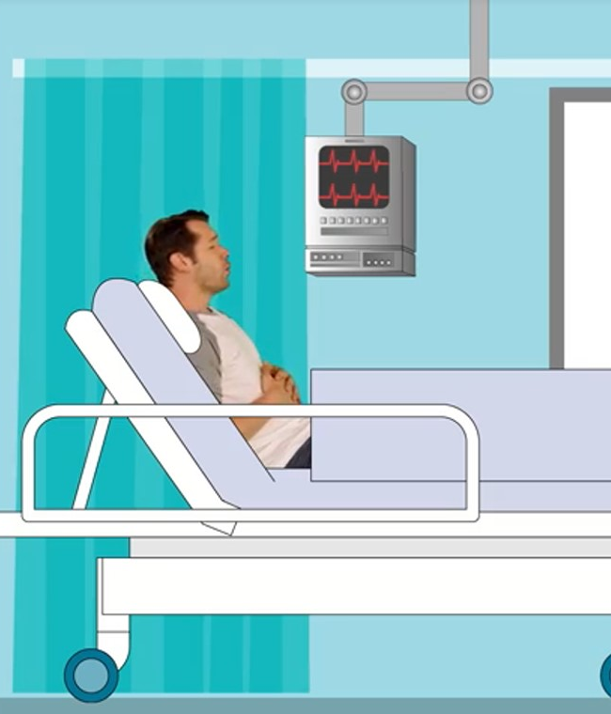
Why Hospital StayPay?
Hospital bills can add up in a hurry.
Charlie’s hospital bills were rough.
His health insurance helped, but it didn’t pay for all of it.
Hospital StayPay paid cash to Charlie on top of his health insurance.
He used it for co-pays and deductibles – and other expenses – while he focused on healing.
Notes:
[For ALL cases.]

Slide 5

Sticker Shock
Are you prepared for the expense?
The average cost of a 3-day hospital stay in the USA is around:
$30,000
Source: www.healthcare.gov/why-coverage-is-important/protection-from-high-medical-costs/, 2024
Notes:
[For ALL cases.]

Slide 6
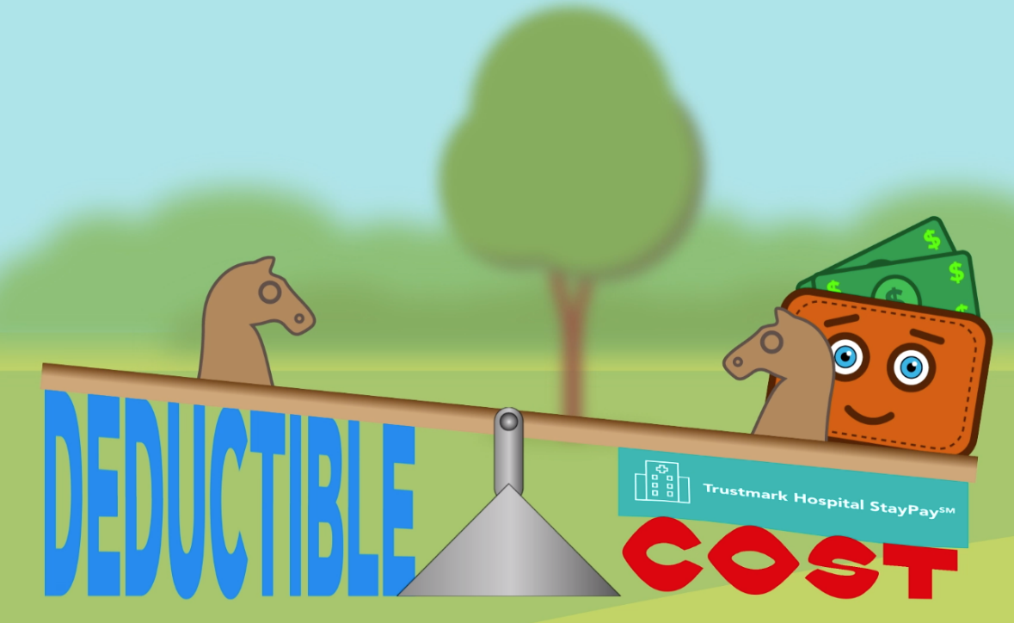
Pairs With Your Medical Insurance
Enhance your health care protection.
Hospital StayPay pays in addition to your health insurance for more complete protection against hospital bills.
Medical insurance alone may not handle all the costs of a hospital stay.
Hospital StayPay can help balance your health insurance deductible with your cost of medical coverage.
Notes:
[For ALL cases.]

Slide 7

How StayPay Works
Your primary benefits:
Your first day stay benefit is paid when you are first admitted to the hospital.†
Benefit amounts differ by plan and employer.
†Benefits marked with this symbol are designed to be compatible with Health Savings Accounts (HSAs). However, anyone who has or plans to open an HSA should consult tax and legal advisors to confirm which supplemental benefits may be purchased by persons with an HSA to maintain tax-exempt status.
Notes:
[For ALL cases.]

Slide 8
How StayPay Works
Your primary benefits:
Your first day stay benefit is paid when you are first admitted to the hospital.†
And you’re paid an additional benefit for each day you’re in the hospital.†
Benefit amounts differ by plan and employer.
†Benefits marked with this symbol are designed to be compatible with Health Savings Accounts (HSAs). However, anyone who has or plans to open an HSA should consult tax and legal advisors to confirm which supplemental benefits may be purchased by persons with an HSA to maintain tax-exempt status.
Notes:
[For cases that include a daily confinement benefit.]

Slide 9
How StayPay Works
Your primary benefits:
Your first day stay benefit is paid when you are first admitted to the hospital.†
And you’re paid an additional benefit for each day you’re in the hospital.†
If you are in an intensive care unit, your daily stay benefit will pay an even higher amount!†
Benefit amounts differ by plan and employer.
†Benefits marked with this symbol are designed to be compatible with Health Savings Accounts (HSAs). However, anyone who has or plans to open an HSA should consult tax and legal advisors to confirm which supplemental benefits may be purchased by persons with an HSA to maintain tax-exempt status.
Notes:
[For cases that include the ICU benefit.]

Slide 10

How StayPay Works
Additional features of your plan
Get money back! A $100 payment will be automatically sent to you every two years that you don’t have a claim – no action needed!†*
Get extra cash! The first time in a calendar year someone on the policy is admitted to the hospital, you’ll receive a boost to your benefit, which could help you meet your deductible.†
Benefit amounts differ by plan and employer.
Feature availability may vary by state.
*Optional benefit.
†Benefits marked with this symbol are designed to be compatible with Health Savings Accounts (HSAs). However, anyone who has or plans to open an HSA should consult tax and legal advisors to confirm which supplemental benefits may be purchased by persons with an HSA to maintain tax-exempt status.
Notes:
[For cases that include BOTH the Claim-Free Return rider and the First Occurrence benefit.]

Slide 11
How StayPay Works
Additional features of your plan
Get money back! A $100 payment will be automatically sent to you every two years that you don’t have a claim – no action needed!†*
Feature availability may vary by state.
*Optional benefit.
†Benefits marked with this symbol are designed to be compatible with Health Savings Accounts (HSAs). However, anyone who has or plans to open an HSA should consult tax and legal advisors to confirm which supplemental benefits may be purchased by persons with an HSA to maintain tax-exempt status.
Notes:
[For cases that include the Claim-Free Return rider but NOT the First Occurrence benefit.]

Slide 12
How StayPay Works
Additional features of your plan
Get extra cash! The first time in a calendar year someone on the policy is admitted to the hospital, you’ll receive a boost to your benefit, which could help you meet your deductible.†
Benefit amounts differ by plan and employer.
Feature availability may vary by state.
†Benefits marked with this symbol are designed to be compatible with Health Savings Accounts (HSAs). However, anyone who has or plans to open an HSA should consult tax and legal advisors to confirm which supplemental benefits may be purchased by persons with an HSA to maintain tax-exempt status.
Notes:
[For cases that include the First Occurrence benefit but NOT the Claim Free Rider.]

Slide 13

More Flexible Features
Wellness Checks
Wellness Checks† can pay for:
  One routine test per year
  One follow-up test, if necessary
Benefit amounts differ by plan and employer.
Feature availability may vary by state.
†Benefits marked with this symbol are designed to be compatible with Health Savings Accounts (HSAs). However, anyone who has or plans to open an HSA should consult tax and legal advisors to confirm which supplemental benefits may be purchased by persons with an HSA to maintain tax-exempt status.
Notes:
[For cases that include Wellness Checks option 1 or 3.]

Slide 14
More Flexible Features
Wellness Checks
Wellness Checks† can pay for:
  One routine test per year
  One follow-up test, if necessary
  One of the following per year:
    Vision test
    Immunization
    Fasting blood glucose test
    Lipid panel
Benefit amounts differ by plan and employer.
Feature availability may vary by state.
†Benefits marked with this symbol are designed to be compatible with Health Savings Accounts (HSAs). However, anyone who has or plans to open an HSA should consult tax and legal advisors to confirm which supplemental benefits may be purchased by persons with an HSA to maintain tax-exempt status.
Notes:
[For cases that include Wellness Checks option 2 or 4.]

Slide 15

More Flexible Features
TrekCheck
TrekCheck pays a benefit if you have to travel more than 50 miles from home for care.
It may also pay a lodging benefit (for overnight stays or short-term rentals) if you’re traveling with an adult companion.
Benefit amounts differ by plan and employer.
Feature availability may vary by state.
Notes:
[For cases that include TrekCheck.]

Slide 16
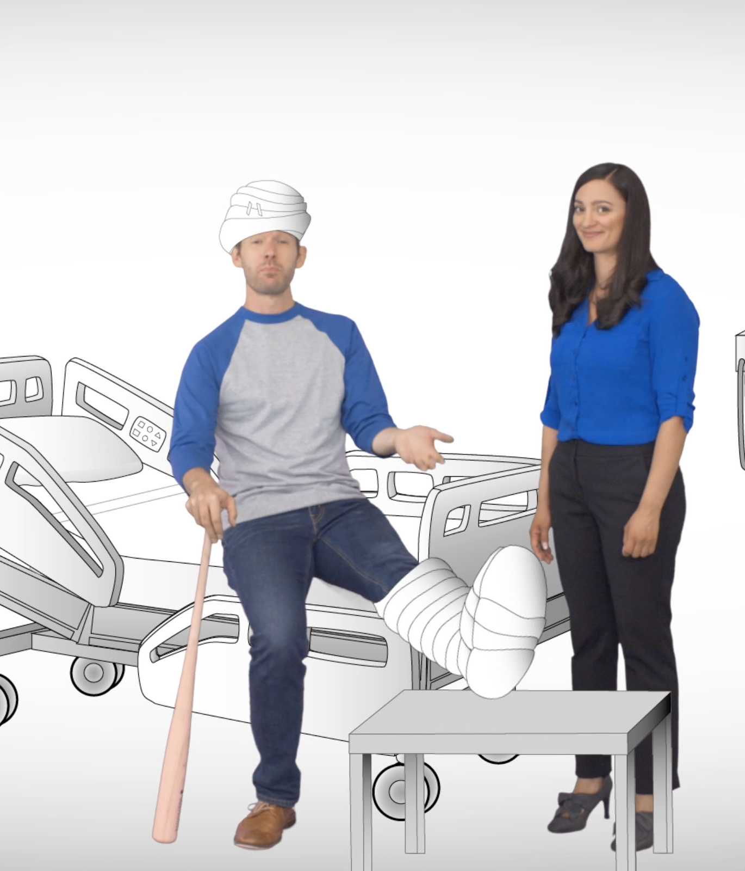
More Flexible Features
Follow-up benefit
With a follow-up benefit, you can get paid for:
one physician-recommended follow-up visit per covered accident or covered sickness, following a hospitalization, emergency room visit, surgery, rehab stay or urgent care visit.
  up to three times per year.
Benefit amounts differ by plan and employer.
Feature availability may vary by state.
Notes:
[For cases that include Follow-Up Care.]

Slide 17

More Flexible Features
Imaging benefit
With an imaging benefit, you can get paid if your hospital visit includes:
  Certain diagnostic medical imaging tests.
Benefit amounts differ by plan and employer.
Feature availability may vary by state.
Notes:
[For cases that include an Imaging benefit.]

Slide 18

More Flexible Features
Immediate care benefit
An immediate care benefit helps pay for:
  Visits to emergency rooms.
Benefit amounts differ by plan and employer.
Feature availability may vary by state.
Notes:
[For cases that include Immediate Care benefit for emergency rooms.]

Slide 19
More Flexible Features
Immediate care benefit
An immediate care benefit helps pay for:
  Visits to urgent care centers.
Benefit amounts differ by plan and employer.
Feature availability may vary by state.
Notes:
[For cases that include Immediate Care benefit for urgent care centers.]

Slide 20
More Flexible Features
Immediate care benefit
An immediate care benefit helps pay for:
  Transportation to a hospital in an ambulance.
Benefit amounts differ by plan and employer.
Feature availability may vary by state.
Notes:
[For cases that include Immediate Care benefit for ambulances.]

Slide 21

More Flexible Features
Rehabilitation services benefit
A rehabilitation services benefit helps pay for:
  Inpatient rehabilitation services.
Benefit amounts differ by plan and employer.
Feature availability may vary by state.
Notes:
[For cases that include Rehab benefit for inpatient rehab.]

Slide 22

More Flexible Features
Rehabilitation services benefit
A rehabilitation services benefit helps pay for:
  Outpatient rehabilitation services.
Benefit amounts differ by plan and employer.
Feature availability may vary by state.
Notes:
[For cases that include Rehab benefit for outpatient rehab.]

Slide 23
More Flexible Features
Rehabilitation services benefit
A rehabilitation services benefit helps pay for:
  Rehabilitation services for mental wellness and addiction recovery.
Benefit amounts differ by plan and employer.
Feature availability may vary by state.
Notes:
[For cases that include Rehab benefit for mental wellness and addiction recovery.]

Slide 24
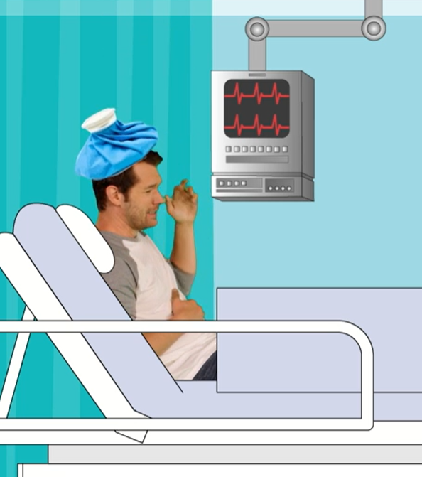
More Flexible Features
Surgery benefit
A surgery benefit helps pay for:
  Inpatient surgery, as well as anesthesia received during your procedure.
Benefit amounts differ by plan and employer.
Feature availability may vary by state.
Notes:
[For cases that include Surgery benefit for inpatient surgery.]

Slide 25
More Flexible Features
Surgery benefit
A surgery benefit helps pay for:
  Outpatient surgery in a hospital, as well as anesthesia received during your procedure.
Benefit amounts differ by plan and employer.
Feature availability may vary by state.
Notes:
[For cases that include Surgery benefit for outpatient surgery in a hospital.]

Slide 26
More Flexible Features
Surgery benefit
A surgery benefit helps pay for:
  Outpatient surgery in a doctor’s office or urgent care facility, as well as anesthesia received during your procedure.
Benefit amounts differ by plan and employer.
Feature availability may vary by state.
Notes:
[For cases that include Surgery benefit for outpatient surgery in a doctor’s office or urgent care facility.]

Slide 27

Flexibility for Life
Adjust your benefit as your needs change.
Hospital StayPay is designed to fit your needs throughout your lifetime.
So if those needs change – or if your health insurance plan changes – you can adjust your primary benefit (first-day stay benefit) immediately, just by giving Trustmark a call!
Benefit adjustment available when you have either a qualifying life event or a change to your medical insurance coverage.
Notes:
[For ALL cases.]

Slide 28


Family Coverage
Apply for family members, too!
Charlie isn’t the only one in his household who would benefit from financial protection.
He can also apply for coverage for his spouse, children and dependent grandchildren.
Notes:
[For cases that include an option for family coverage.]

Slide 29

Trustmark Advantage
Benefits are simple – and you own them.
As a Trustmark Hospital StayPay insurance policyholder, you enjoy several additional advantages:
● Your rate will never increase (and coverage will never decrease) due to age.
● Your payments are deducted out of your paycheck – no bills to remember or deal with.
● You can keep your coverage at the same price and benefits, even if you change jobs or retire – you can pay by direct bill, automatic deduction or with a credit card.
Notes:
[For ALL cases.]

Slide 30

Any
questions?
Trustmark Hospital StayPay® insurance is underwritten by Trustmark Insurance Company, Lake Forest, Illinois.
This is a brief description of benefits under HII 119 and applicable riders CFR 119, CCR 119, FUR 119, IBR 119, ICR 119, RSR 119, SBR 119, TLR 119 and WBW 119. This hospital indemnity insurance policy/group certificate provides limited benefits that are the result of a covered accident or covered sickness. It is not a substitute for medical expense insurance, major medical expense insurance or a health benefit plan alternative. It does not provide comprehensive medical coverage. It is also not a Medicare Supplement policy, nor is it a policy of worker’s compensation. Limitations on pre-existing conditions may apply. Benefits, definitions, exclusions, form numbers and limitations may vary by state. Not all plans offered may feature all benefits mentioned. Your policy/certificate will contain complete information. For costs and coverage detail, including exclusions, limitations and terms, see your agent or write the company. Underwriting conditions may vary, and determine eligibility for the offer of insurance. For exclusions and limitations that may apply, please visit trustmarkbenefits.com/Voluntary-Benefits/Disclosures/HSP
A112-2567
Notes:
[For ALL cases.]

