Slide 1


Slide 2

Employee benefit communication is essential.

Slide 3

In fact, benefits communication and employee satisfaction go hand in hand.

Slide 4

Which makes communication crucial because…
30% of an employee’s compensation comes in the form of benefits.
Employer Costs for Employee Compensation, Bureau of Labor Statistics, March 2017.

Slide 5

That’s a lot of lost value if employees aren’t enrolling or don’t appreciate the value of their benefits.

Slide 6
It’s not just about finances, higher employee benefits satisfaction can:
Improve employee retention
Reduce absenteeism
Increase employee loyalty
Boost productivity

Slide 7

Just how important is effective communication?

Slide 8
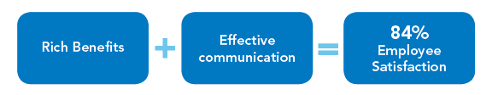
Just how important is effective communication?
It helps employees appreciate a quality benefits program…

Slide 9
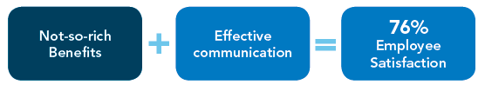
Just how important is effective communication?
It helps employees appreciate a quality benefits program…
It even helps when the benefits aren’t that strong…

Slide 10
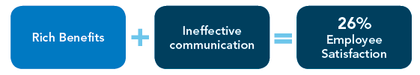
Just how important is effective communication?
It helps employees appreciate a quality benefits program…
It even helps when the benefits aren’t that strong…
Without it, even a solid offering doesn’t mean much…

Slide 11

Employees want communication too
95% of employees say they need someone to talk to about their benefits
90% of employees who enroll one-on-one with a benefits counselor express high levels of satisfaction

Slide 12
So,
how can
Trustmark
help?

Slide 13


Trustmark has more than 100 years of industry experience
We partner with leading communication and enrollment firms to create tailored communication plans to reach employees

Slide 14

Through our partners, we offer a wide range of communication tools to match clients’ needs and ensure the success of an employer’s benefits program.

Slide 15

We can reach employees through a variety of methods including:
Call center

Slide 16

We can reach employees through a variety of methods including:
Call center
Web self-service

Slide 17

We can reach employees through a variety of methods including:
Call center
Web self-service
One-on-one

Slide 18

We can reach employees through a variety of methods including:
Call center
Web self-service
One-on-one
Enroller-assisted

Slide 19

We also use communication to support employer initiatives.

Slide 20
We also use communication to support employer initiatives.
401(k) education
High-deductible health plan education (HDHP)
Dependent audits
Wellness programs
Customer service initiatives
Organizational alignment
And more…

Slide 21

We have extensive experience in a variety of markets. So we understand the unique communication, enrollment and administrative challenges of each industry.

Slide 22

Education - experience where it counts
Trustmark works with more than 200 school districts, colleges and universities
NUMBERS

Slide 23
Education - experience where it counts
Trustmark works with more than 200 school districts, colleges and universities
Our clients range in size from 100 to 30,000+ employees
NUMBERS

Slide 24
Education - experience where it counts
Trustmark works with more than 200 school districts, colleges and universities
Our clients range in size from 100 to 30,000+ employees
Our flexible payroll deduction allows us to meet the pay schedule of educators
NUMBERS

Slide 25

Specializing in healthcare
Trustmark also specializes in healthcare.

Slide 26

Specializing in healthcare
We work with more than 305 hospitals ranging in size from under 100 to 10,000+ employees.

Slide 27

Specializing in healthcare
We help employees understand the unique way in which their performance relates to compensation. We also can schedule enrollment to ensure minimum disruption to work.

Slide 28

Where else can we help?
Public sector
We work with more than 296 clients in the public sector.

Slide 29
Where else can we help?
Public sector
We know how to tailor our communication to these workers and coordinate enrollment and communication for dispersed workforces.

Slide 30

Private Industry
We’re used to adapting. We work with a wide range of private industry fields including:
Manufacturing
Waste management
Financial services
And many more…
Notes:
http://www.gettyimages.com/license/537379518

Slide 31
Private Industry
Our flexible payroll deduction, innovative product suite and customizable communication solutions allow us to meet the needs of any employer.
Notes:
http://www.gettyimages.com/license/537379518

Slide 32

How does
Trustmark
make communication work?

Slide 33

We provide tailored materials for each enrollment to match our clients’ branding, messaging and exact enrollment information.

Slide 34
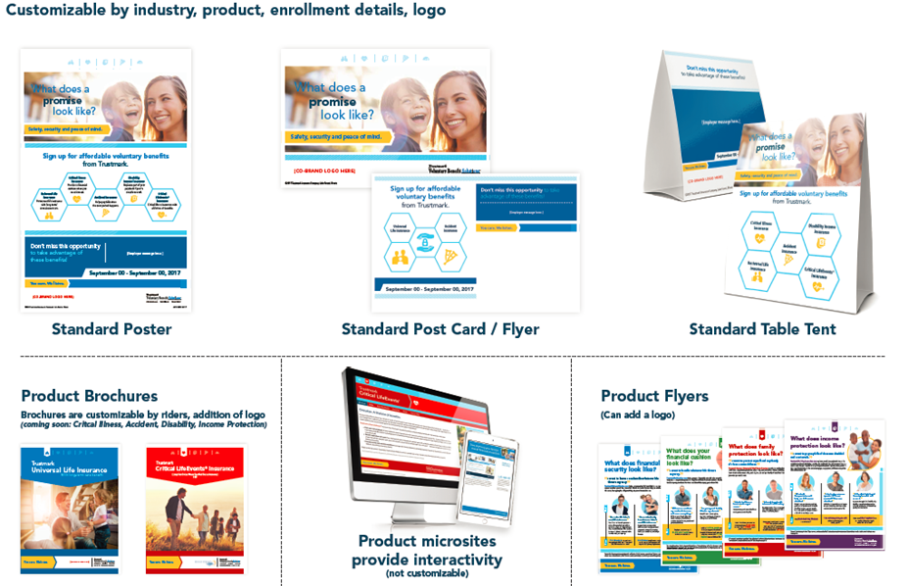
We provide tailored materials for each enrollment to match our clients’ branding, messaging and exact enrollment information.
Digital Content
Microsites and email

Slide 35

We provide tailored materials for each enrollment to match our clients’ branding, messaging and exact enrollment information.
Digital Content
Display
Microsites and email
Table tents, posters and desk drops

Slide 36


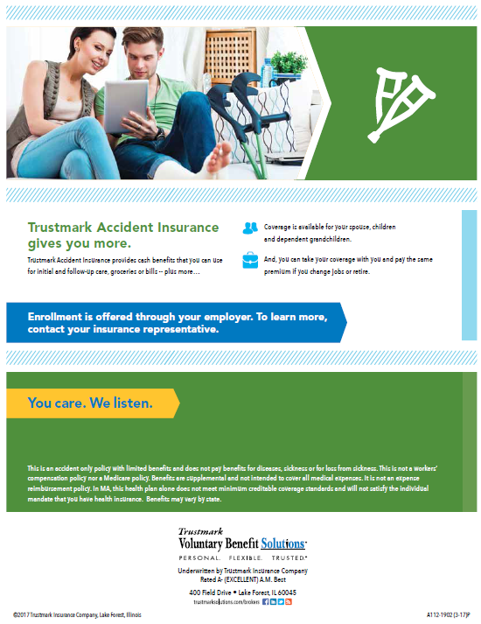
We provide tailored materials for each enrollment to match our clients’ branding, messaging and exact enrollment information.
Digital Content
Display
Print materials
Microsites and email
Table tents, posters and desk drops
Microsites and email
Brochures and one-page slicks

Slide 37

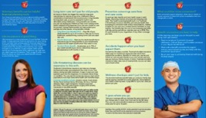



Advanced Campaigns
For some cases, we can provide completely customized communication tailored exactly to an employer’s specifications to improve engagement and increase participation.

Slide 38
Advanced Campaigns
We take everything into account to create a one-of-a-kind enrollment experience:
Industry
Employee demographics
Designated employer messaging
Products offered
Enrollment timing

Slide 39

Hold on, this sounds good,
but does it work?

Slide 40

We’re glad you asked! Let’s take a look at our results working with a Florida school district with 40,000 employees.

Slide 41
Florida School District – 40,000 Employees
We started with a customized communication campaign to increase awareness and raise participation in the existing wellness program

Slide 42
Florida School District – 40,000 Employees
We started with a customized communication campaign to increase awareness and raise participation in the existing wellness program
Which lead to 22 percent of employees seen for a one-on-one benefits enrollment

Slide 43
Florida School District – 40,000 Employees
We started with a customized communication campaign to increase awareness and raise participation in the existing wellness program
Which lead to 22 percent of employees seen for a one-on-one benefits enrollment
13,293 enrollees in the wellness program
2,465 new Universal Life applications
13,293 new Critical Illness applications

Slide 44

We’ve also worked with a retail corporation employing more than 13,000 associates in 29 states across 260 separate locations.

Slide 45
Retail Client – 13,000 Employees
Coordination with our enrollment partner allows us to send a representative to each location to provide communication and engagement

Slide 46
Retail Client – 13,000 Employees
Coordination with our enrollment partner allows us to send a representative to each location to provide communication and engagement
The program has worked so effectively, that we’ve maintained the program for more than 13 years

Slide 47
Retail Client – 13,000 Employees
Coordination with our enrollment partner allows us to send a representative to each location to provide communication and engagement
The program has worked so effectively, that we’ve maintained the program for more than 13 years
Allowing the employer to engage employees on a wide range of important topics along with their benefits communication:
401(k)
Wellness
Dependent audit
HDHP Education
Customer service training

Slide 48
Everything Trustmark does
starts with you.

Slide 49

We’re here to listen and tailor our communication solutions to your needs. Reach out to learn more about Trustmark.
www.trustmarksolutions.com/contact-us

Slide 50

We’re here to listen and tailor our communication solutions to your needs. Reach out to learn more about Trustmark.
www.trustmarksolutions.com/contact-us

Slide 51
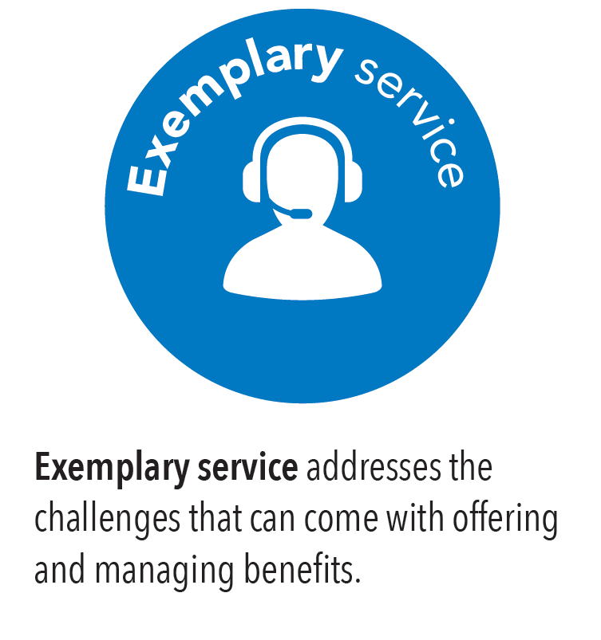
We’re here to listen and tailor our communication solutions to your needs. Reach out to learn more about Trustmark.
www.trustmarksolutions.com/contact-us

Slide 52
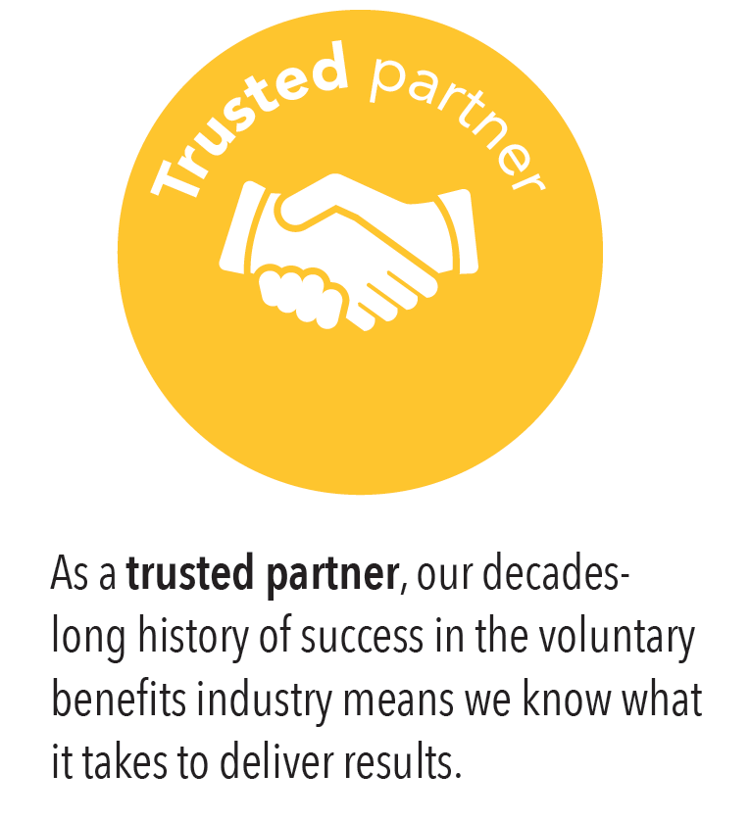
We’re here to listen and tailor our communication solutions to your needs. Reach out to learn more about Trustmark.
www.trustmarksolutions.com/contact-us

Slide 53
Visit www.trustmarksolutions.com

